Slide 1
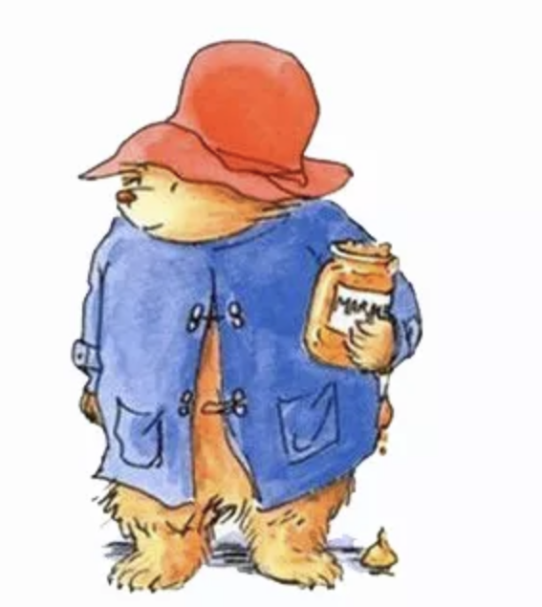
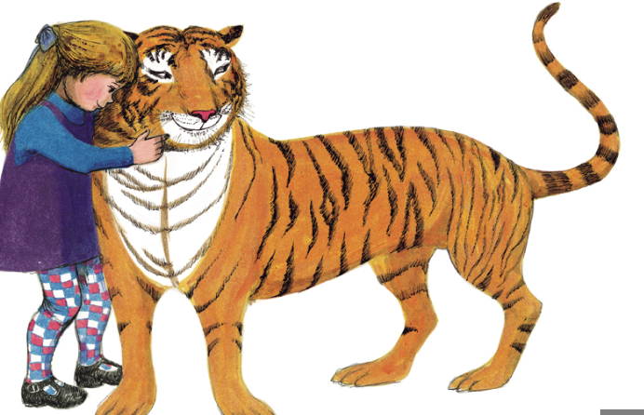
What is a Character?

Slide 2
AIMS OF THE LESSON:
To learn what a character is.
SUCCESS CRITERIA:
I can describe what a character is.
I can describe what a character looks like.
I can write a character description.

Slide 3
What is a character?

Slide 4
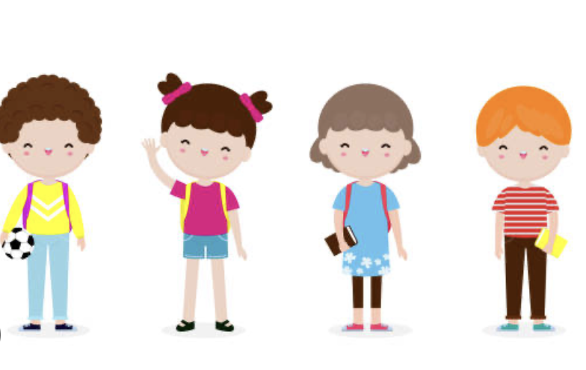
Every story has characters.
These characters can be people, animals or objects that have been brought to life.
Can you name some of your favourite characters from a book you have read?

Slide 5
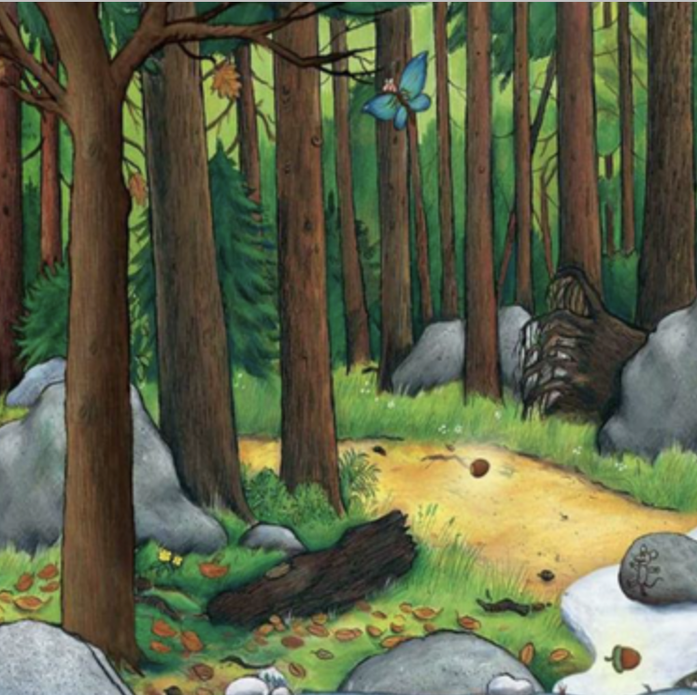
Which character is this?

Slide 6
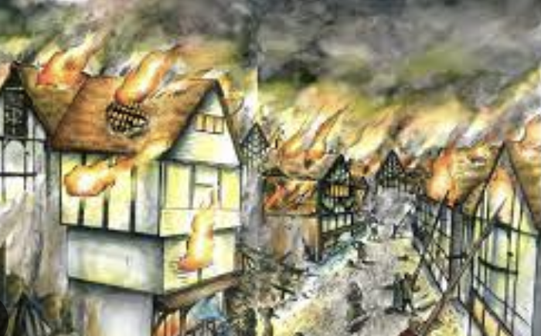
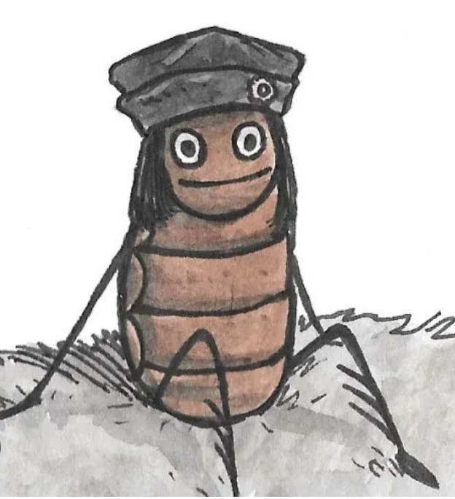
Which character is this?

Slide 7
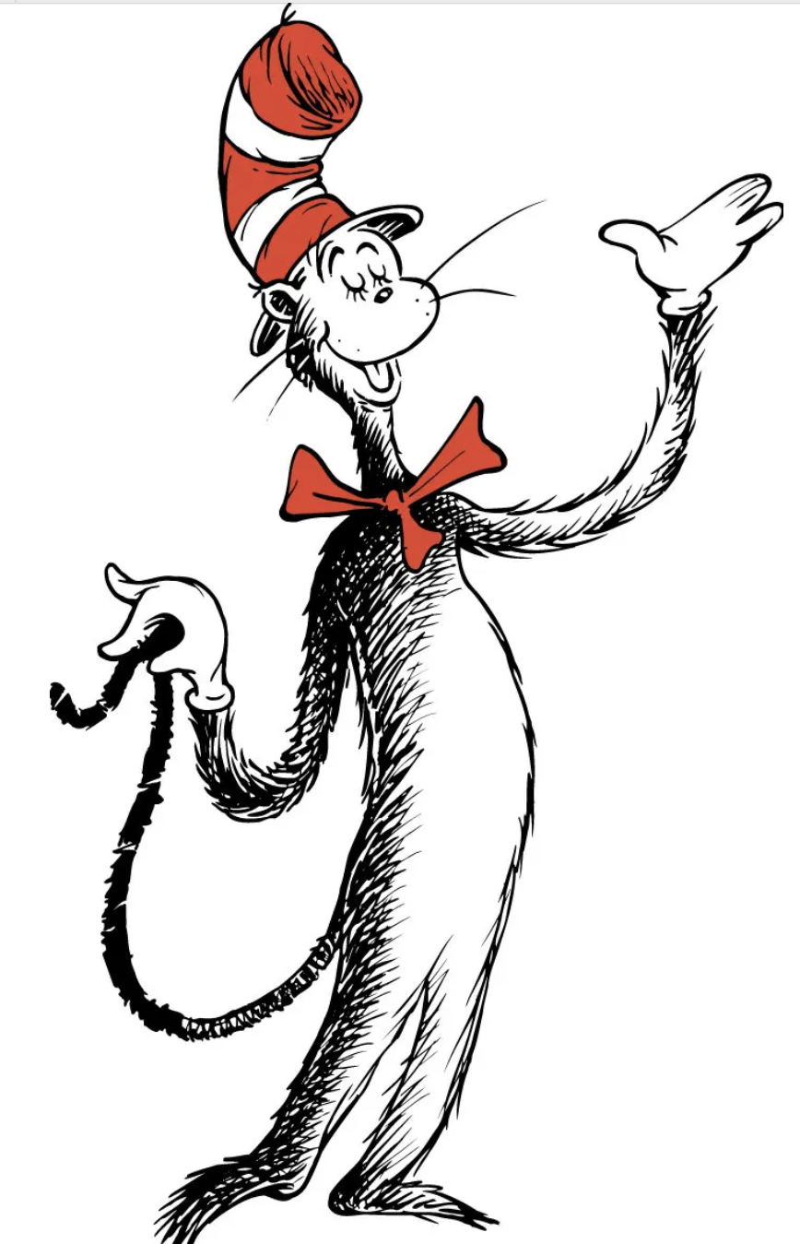
Can you help me describe this character?

Slide 8
Writing a character description
Lets think about…
Our character
Their name
The setting- where do they live?
How old is your character
Do they have any hobbies?
Do they have any magical powers?

