Slide 1
Singapore Maths
Information for Parents and Carers

Slide 2
What is Singapore Maths?
There is no Singapore Maths!
Process of teaching and learning based on decades of educational theory and research.
The system referred is now referred as the ‘Singapore Method’.

Slide 3
Historic Picture
Singapore was:
Lagging behind in the PISA tables (Programme for International Student Assessment).
Landlocked country with imposed independence-education is the only real route to employment.
Maths was taught through ‘English’ method:
Procedure, Memorisation, Computation
(learning ‘tricks’ pages of calculations with increasingly bigger numbers but no ability to see where this has value and use i.e. how to apply it)

Slide 4
Action
Wide ranging study of educational theory.
Development of a system that:
Challenges top third
Enables middle third to perform highly.
Allows lower third to attain competency and does not disadvantage them in any way.
System known as the Singapore Method:
Concrete, Pictorial, Abstract

Slide 5
Singapore Method:
Develops number sense.
Child takes ownership of their learning:
System based on:
Visualisation-Bruner
Generalisation-Vygotsky
Number Sense-Skemp
Communication-Dienes
Metacognition-Flavell
‘Learning is not because my teacher told me so. Learning is because I figured it out.’ (Piaget)

Slide 7
The Lesson:
Story focus (problem)
Practical, concrete investigation draws the maths out. (manipulatives)
Communication and peer support are a key factor.
Visualisation central (imagine) and pictorial representation (show me)
Challenged to communicate methods in as many different ways as possible.
Abstract (number sentences and equations)is the final point.
Carefully researched and theory based textbook.
Differentiation through process, product and effective environment.

Slide 8
Outcome
Singapore consistently tops the PISA tables.
99% of students follow maths to A level as they see it as the ‘easy option’
This what we aspire to for our children in
Dawpool.

Slide 9
What stage are we at in Dawpool:
Initial research began over 2 years ago when the National Curriculum emphasis became more focused on problem solving and reasoning.
Mrs Young has been part of the Deep Learning Alliance- backed by North West 3 Maths Hub to research and develop Singapore Maths in primary schools.
Training for staff began last academic year and the method was launched in September.
Years 1-3 are fully resourced and following this method.
Years 4-6 have begun to follow the Concrete, Pictorial, Abstract approach in lessons and the resources have been purchased ready to implement Singapore Maths fully from September 2016.
EYFS are developing the curriculum in line with this approach.

Slide 10
What is the impact so far?
Feedback from staff has been very positive.
Feedback from children has been overwhelmingly positive.
More and more research both independent and Government backed is supporting that this is the most effective way of teaching maths for all pupils.
We are ahead of the curve.

Slide 11
Impact so far…
Higher level of engagement from all children despite a very challenging curriculum
Children are eager to hear the ‘story’ and problem solve for others
Children always have a ‘route in’ and are challenged to think for themselves from the beginning of the lesson
Children have a partner to support

Slide 12
All children have been able to access Year 1,2 and 3 Maths
• Narrowing gap
• Timely intervention

Slide 13
Children are learning from each other
Partnership ensures mathematical communication and reasoning is developed for both partners
Understanding for most able is enhanced too

Slide 14
Children attempt to problem solve more readily
• Maths is seen as a route to solving problems
• Willingness to try something completely new has increased
• Children are choosing their own approach according to their level of mathematical development

Slide 15
Enrichment activities are allowing children to dig even deeper if they are ready to do so
• Children are beginning to explain, clarify, extend, find new ways, create own questions

Slide 16
What does a lesson look like?
Year 1 lesson looking at making number bonds

Slide 19
Journaling
Children record their understanding of the problem and how they have solved it in their maths journal.
Some days it is ‘teacher’s day to choose’ but children also have the opportunity to show their own methods.
Children are encouraged to find more than one way to solve the problem.
This underpins the focus towards reasoning in the National Curriculum

Slide 20
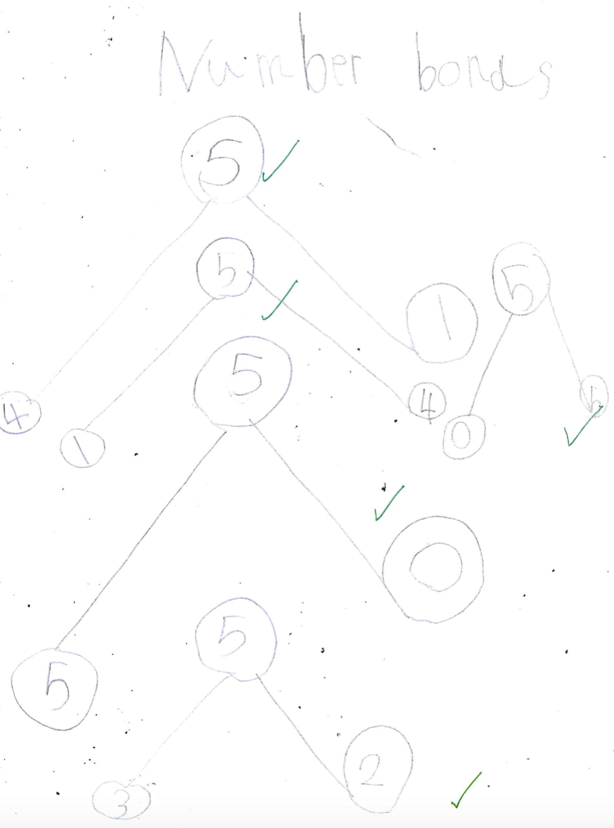
Journaling
A Year 1 Example

Slide 21
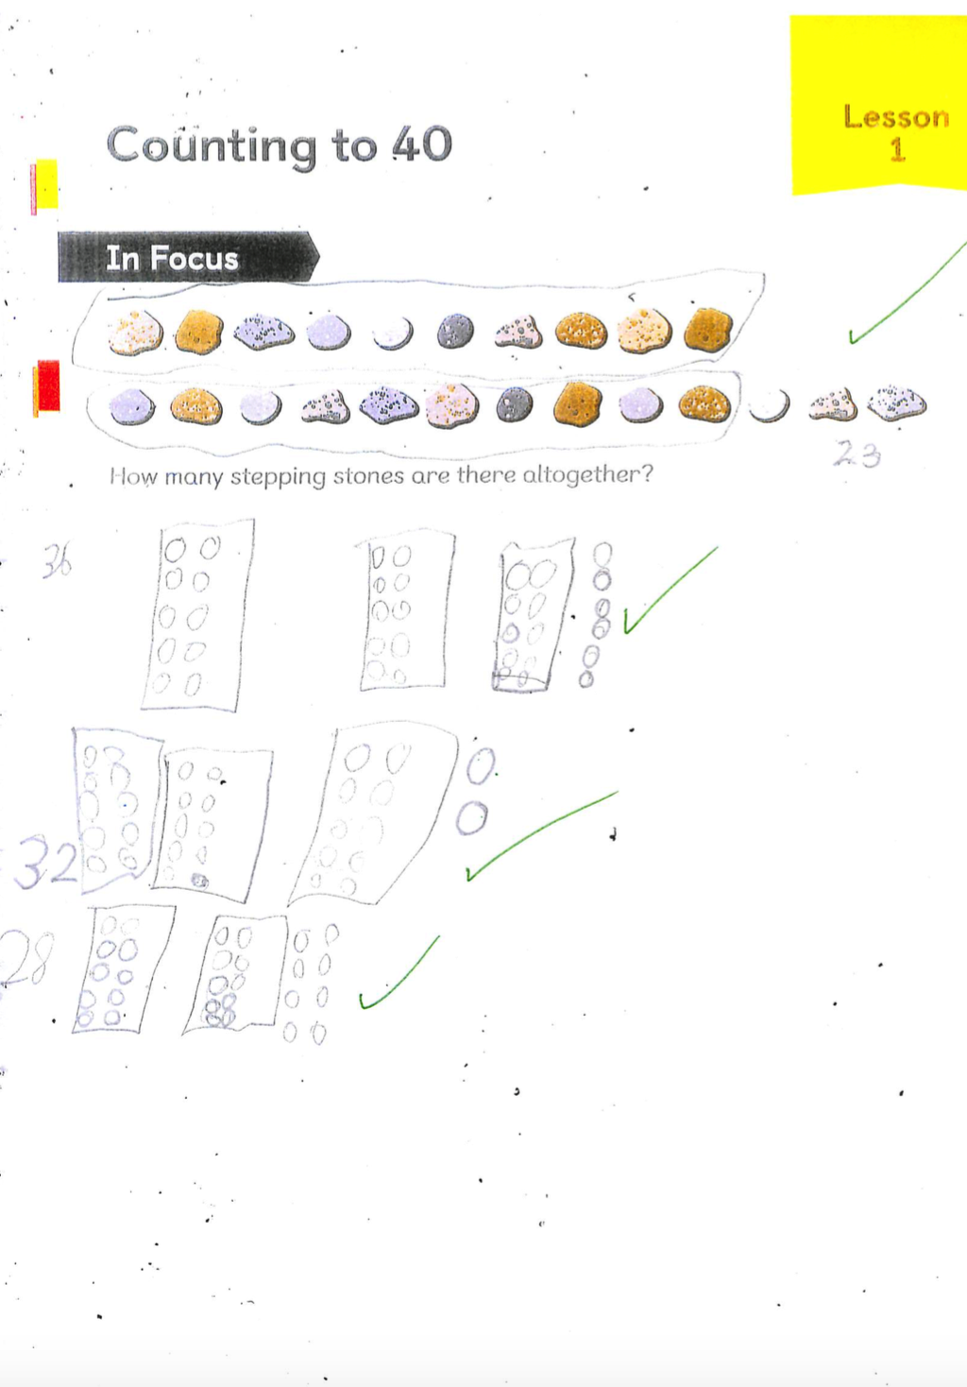
Journaling
A Year 1 Example

Slide 22
Journaling
A Year 1 Example

Slide 23
Journaling
A Year 1 Example

Slide 24
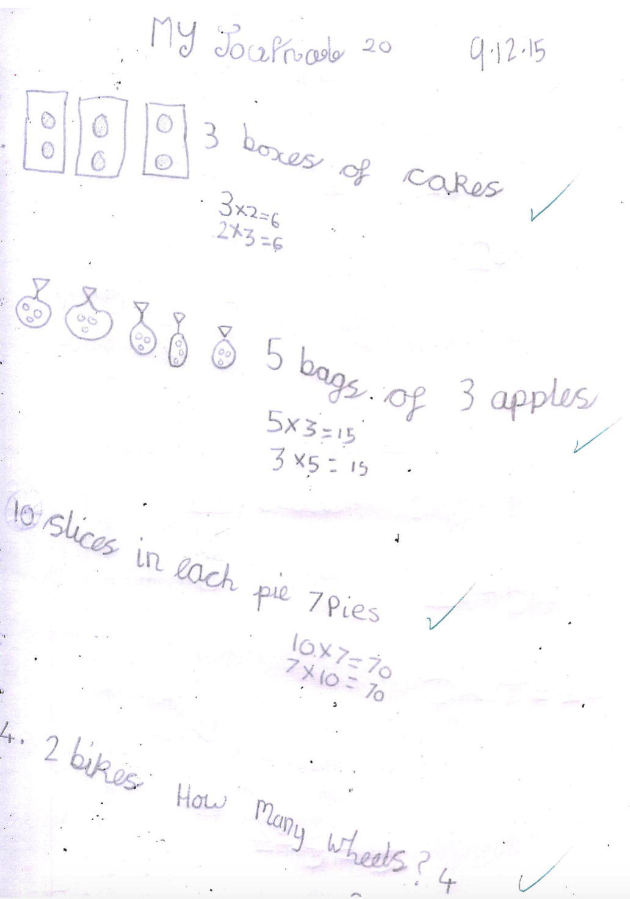
Journaling
A Year 2 Example

Slide 25
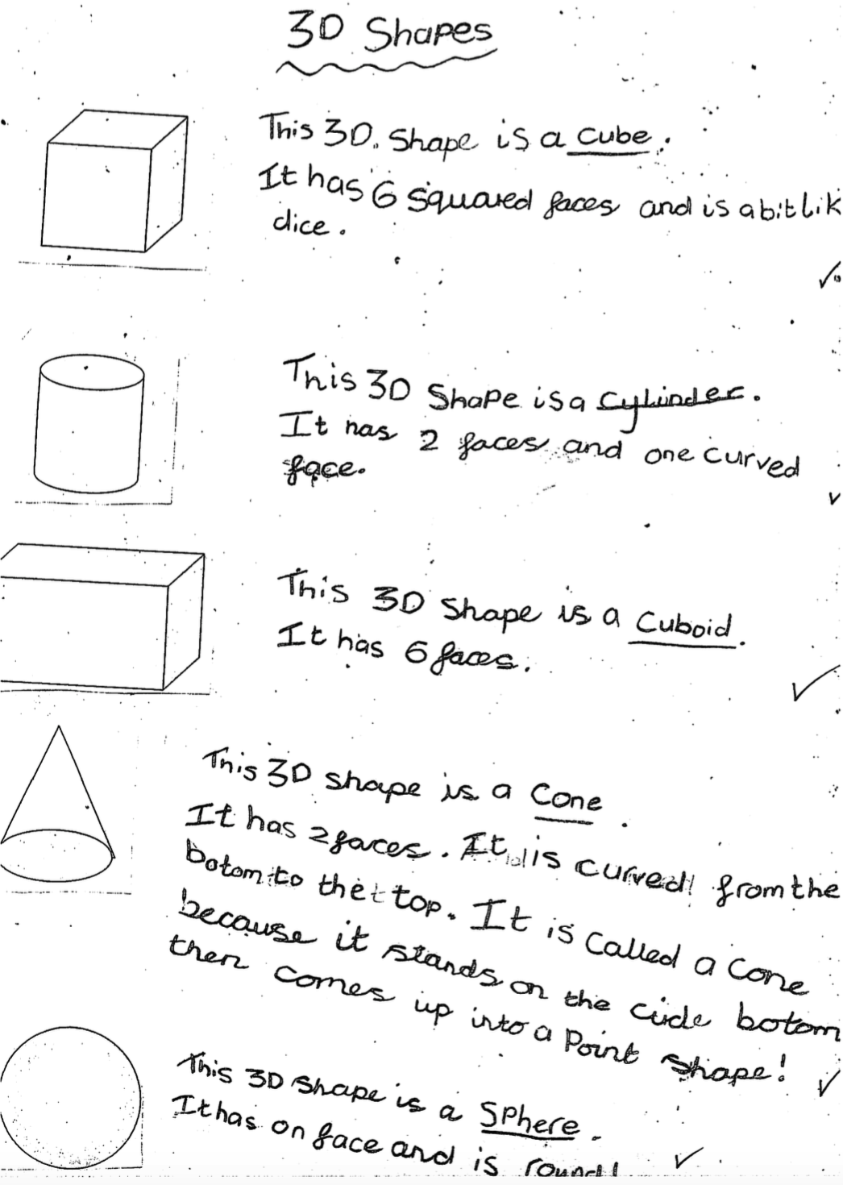
Journaling
A Year 2 Example

Slide 26
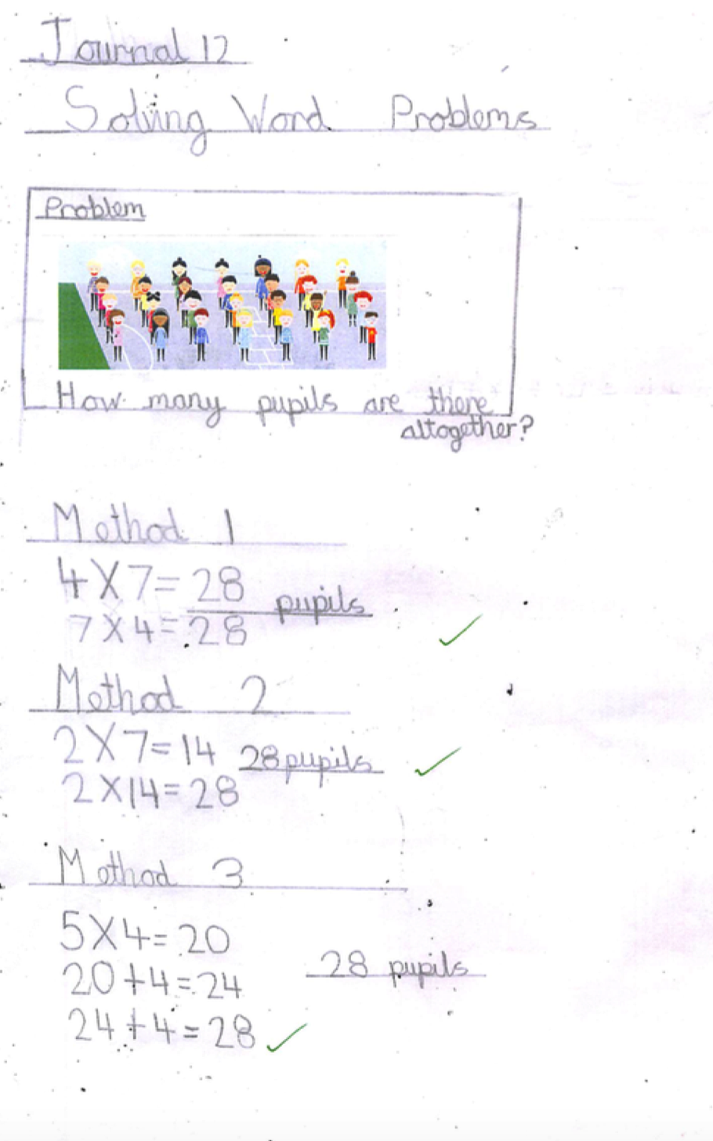
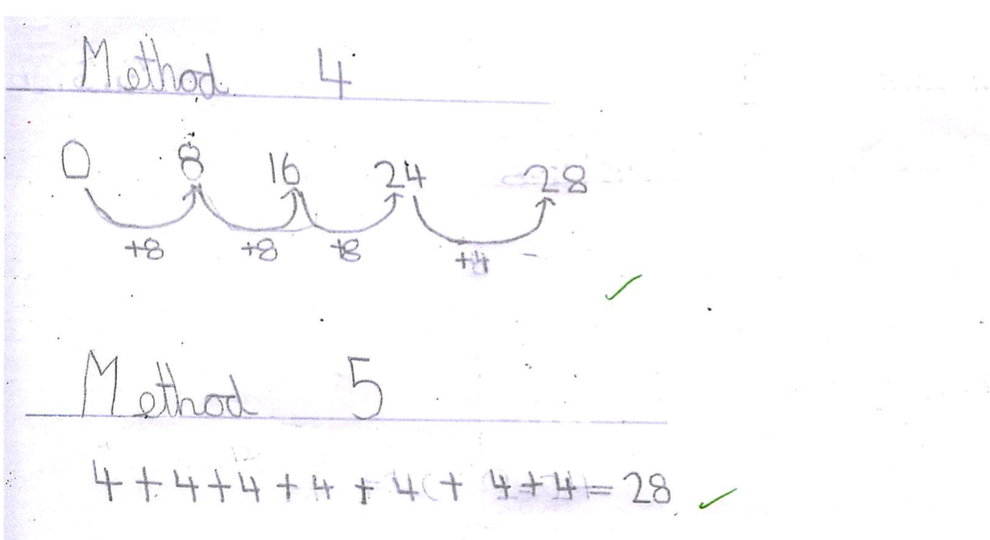
Journaling
A Year 3 Example

Slide 27
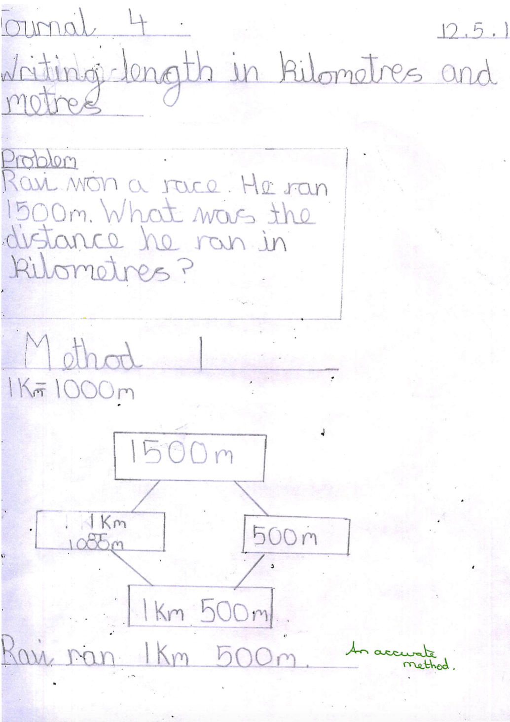
Journaling
A Year 3 Example

Slide 28
What can you do to support at home? Growth Mindset
Carol Dweck research
The Singapore approach requires the children to have a ‘Growth Mindset’ rather than a ‘Fixed Mindset’
Parents need to have a Growth Mindset if they are to best support their children in maths.

Slide 29
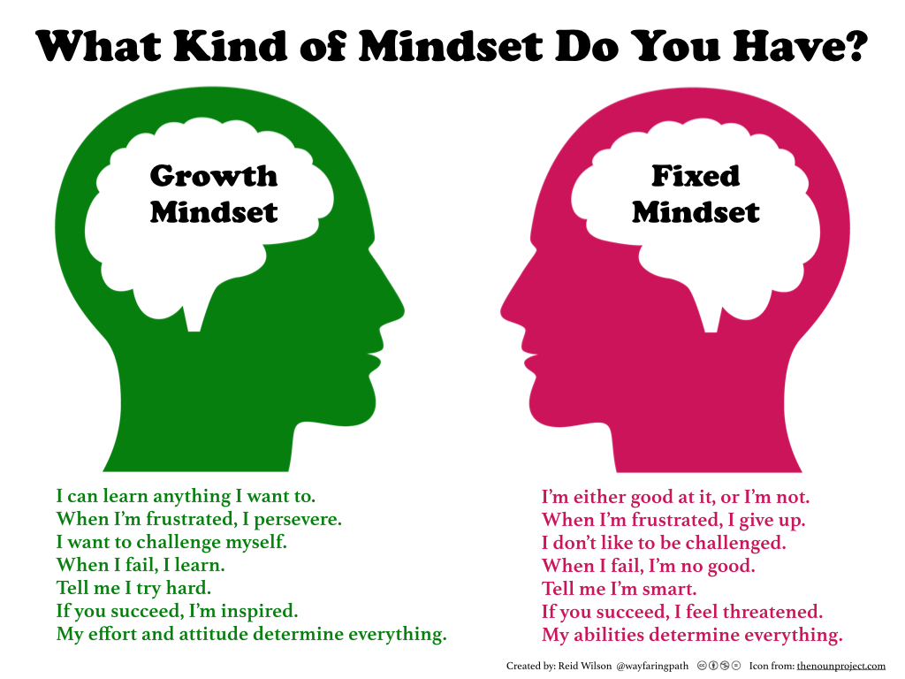

Slide 30
Singapore method does require:
Resilience to keep going, to try to find a way into a problem.
Communication to explain your method of working not simply say ‘I know the answer’.
Determination to find the ‘plan’ to lead to a solution and the determination to carry it through.
Aspiration : I can try this, I can use all I know to seek a solution.
Motivation: I can find another way, I can find other interesting aspects to this maths story.

Slide 31
Singapore method discourages:
I know culture: I know the answer but I cannot explain how I got there.
I’m finished: I am not able to find anything else that is interesting in this number story, I’m not able to find another way. Good mathematicians will never be finished or bored!
I can’t: this looks hard, I won’t be able to do this.
Complacency: I know how to lots of calculations with big numbers: I am not sure which calculation fits with which context though.

Slide 32
Maths in Foundation Stage 2
Early Learning Goal Mathematics
Numbers: Children count reliably with numbers from 1 to 20, place them in order and say which number is one more or one less than a given number. Using quantities and objects, they add and subtract two single-digit numbers and count on or back to find the answer. They solve problems, including doubling, halving and sharing. Shape, space and measures: Children use everyday language to talk about size, weight, capacity, position, distance, time and money to compare quantities and objects and to solve problems. They recognise, create and describe patterns. They explore characteristics of everyday objects and shapes and use mathematical language to describe them.

Slide 33
Don’t take the basics for granted…
Touch and count…always.
Fingers…your best and first resource.
Count into pots/cups…hearing helps!
All about 1,2,3,4,5,6,7,8,9,10.
Count on, count back-not always from the same number.
Language of more and less.

Slide 34
Practical anchor task….
Can you make some cakes for Sammy and Maisie’s birthday using playdough? Share them out on 2 plates. How many cakes have they got each and altogether?
3 + 3 =
6

Slide 35
The National Curriculum
‘become fluent in the fundamentals of mathematics, including through varied and frequent practice with increasingly complex problems over time, so that pupils develop conceptual understanding and the ability to recall and apply knowledge rapidly and accurately.’
‘reason mathematically by following a line of enquiry, conjecturing relationships and generalisation, and developing an argument, justification or proof using mathematical language’
‘solve problems by applying their mathematics to a variety of routine and non routine problems with increasing sophistication, including breaking down problems into a series of simpler steps and persevering in seeking solutions.’

Slide 36
National Statutory Tests
KS1 –Arithmetic Paper
KS2- Arithmetic Paper and two Problem Solving and Reasoning Papers
National Curriculum Programme of Study states:
‘A high quality mathematical education therefore provides a foundation for understanding the world, the ability to reason mathematically, an appreciation of the beauty and power of mathematics, and a sense of enjoyment and curiosity about the subject.’

Slide 37
Time to explore.
Please spend some time looking at the samples of:
Singapore Method ‘Maths No Problem text books
Sample SATs papers
Manipulatives (concrete resources) to support maths

Slide 38
‘I like Singapore Maths as even though it’s not easier Maths, it’s an easier method to learn and a fun way to learn.’

