Slide 1
Ready-to-go Lesson Slides
Year 6
Number: Algebra
Lesson 7
Spr3

Slide 3
Starter:
Success Criteria: I can solve one step equations I can use equipment to help me I know how to use the balancing method involving inverse operations to solve equations
Which one is different?
The difference between 23 and 15 is y.
I am thinking of a number.
I add 15 to it and get the answer 23.
23 is 15 more than my number.
I am thinking of a number.
It is 15 more than 23.
15 is __ less
than 23.

Slide 4
Starter:
Success Criteria: I can solve one step equations I can use equipment to help me I know how to use the balancing method involving inverse operations to solve equations
Which one is different?
The difference between 23 and 15 is y.
I am thinking of a number.
I add 15 to it and get the answer 23.
23 is 15 more than my number.
I am thinking of a number.
It is 15 more than 23.
15 is __ less
than 23.
Although these statements look similar, this one is the odd one out. All the other statements can be described by the equation y + 15 = 23.
However, this statement can be described by y = 23 + 15 instead.

Slide 5
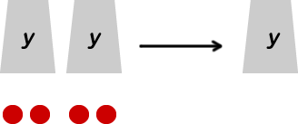
Talking time:
How many balls are in one cup?
Write this problem as a one-step equation.

Slide 6
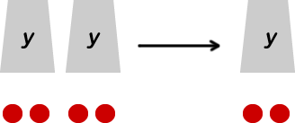
Talking time:
How many balls are in one cup?
Write this problem as a one-step equation.
There are 4 balls in two cups. 2y = 4
So, we know there are 2 balls in one cup. y = 2

Slide 7
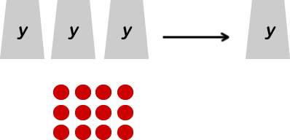
Talking time:
How many balls are in one cup?
Write this problem as a one-step equation.

Slide 8
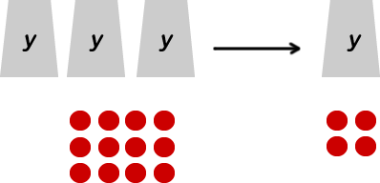
Talking time:
How many balls are in one cup?
Write this problem as a one-step equation.
There are 12 balls in three cups. 3y = 12
So, we know there are 2 balls in one cup. y = 4

Slide 9
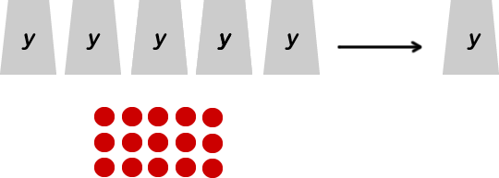
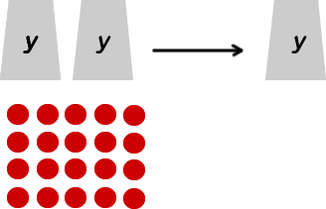
Activity 1:
How many balls are in one cup?
Write each problem as a one-step equation.

Slide 10
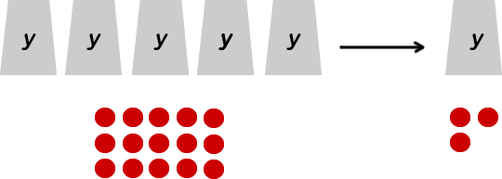
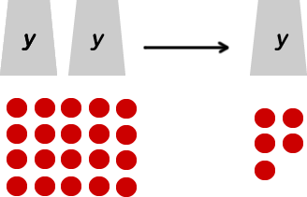
Activity 1:
How many balls are in one cup?
Write each problem as a one-step equation.
5y = 15
So, y = 3
2y = 10
So, y = 5

Slide 11
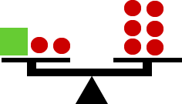
Talking time:
Ross gets a set of scales to balance.
How can he write this as a one-step equation?
Show how he can work out what the green cube is worth.

Slide 12
Talking time:
Ross gets a set of scales to balance.
How can he write this as a one-step equation?
Show how he can work out what the green cube is worth.
a + 2 = 6
We know that the cube plus two balls equals the same mass as six balls.
So, the cube must weigh the same as four balls (because 4 + 2 = 6)
So, a = 4

Slide 13
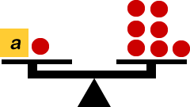
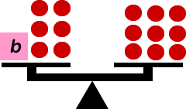
Activity 2:
Write these as one-step equations and then solve them to find
the value of each cube.

Slide 14
Activity 2:
Write these as one-step equations and then solve them to find
the value of each cube.
a + 1 = 7
So, a = 6
Extension
Design some similar problems of your own.
Is it possible to make a physical version of these problems, using real-life maths equipment?
b + 6 = 9
So, b = 3

Slide 15
Talking time:
How would you represent this equation as a bar model?
5y = 30

Slide 16
Talking time:
How would you represent this equation as a bar model?
5y = 30
y = 6

Slide 17
Activity 3:
Match each bar model with the equation that it represents.
20 – b = 4
4b = 20
13 + 4 = b
b + 13 = 20

Slide 18
Activity 3:
Match each bar model with the equation that it represents.
20 – b = 4
4b = 20
13 + 4 = b
b + 13 = 20

Slide 19
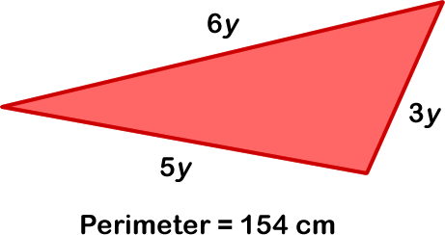
Activity 4:
Work out the length of each side of the triangle by writing
equations based on the information you can see.
How many lots of ‘y’ are there in the whole perimeter?
If we know the number of lots of ‘y’, how can we use this to find out what y is worth?
If we know what ‘y’ is worth, how can we use this to calculate each side length?

Slide 20
Activity 4:
Work out the length of each side of the triangle by writing
equations based on the information you can see.
6y + 5y + 3y = 14y
14y = 154
154 ÷ 14 = 11
So, y = 11
6y = 6 x 11 = 66cm 3y = 3 x 11 = 33cm 5y = 5 x 11 = 55cm
So, the side lengths are 66cm, 33cm and 55cm

Slide 21
Activity 5:
Mo is 11 years old.
Amir is 15 years old.
Mum is x + 20 years old.
The sum of their ages is 65.
Write an equation to help you find out how old Mum is.

Slide 22
Activity 5:
Mo is 11 years old.
Amir is 15 years old.
Mum is x + 20 years old.
The sum of their ages is 65.
Write an equation to help you find out how old Mum is.
11 + 15 + x + 20 = 65
So, if we subtract 11, 15 and 20 from 65, we should be left with x.
65 – 11 = 54
54 – 15 = 39
39 – 20 = 19 So, x = 19
19 + 20 = 39 So, Mum is 39 years old.
Can you see how you can find the answer more quickly?
Look carefully at the method opposite!

Slide 23
Evaluation:
Success Criteria: I can solve one step equations I can use equipment to help me I know how to use the balancing method involving inverse operations to solve equations
True or False?
The equation 59 – x = 46 can be represented by this
bar model:
If a + 9 = 15, then a must be worth 24 because 9 + 15
equals 24.
If 8j = 16, then j = 2
If 4 lots of an unknown number equals 36, then this can be expressed as
4 + y = 36
If 30 is 4 more than b, this can be written as the equation b + 4 = 30.

Slide 24
Evaluation:
Success Criteria: I can solve one step equations I can use equipment to help me I know how to use the balancing method involving inverse operations to solve equations
True or False?
The equation 59 – x = 46 can be represented by this
bar model: TRUE
If a + 9 = 15, then a must be worth 24 because 9 + 15
equals 24. FALSE
If 8j = 16, then j = 2 TRUE
If 4 lots of an unknown number equals 36, then this can be expressed as
4 + y = 36 FALSE
If 30 is 4 more than b, this can be written as the equation b + 4 = 30.
TRUE

