Slide 1
Ready-to-go Lesson Slides
Year 6
Number: Algebra
Lesson 8
Spr3

Slide 3
Starter:
Success Criteria: I can solve two step equations I can use equipment to help me I know how to use the balancing method involving inverse operations to solve equations
Which one is different?
x + 13 = 25
x ÷ 3 = 4
31 – x = 20
5x = 60
45 + x = 57

Slide 4
Starter:
Success Criteria: I can solve two step equations I can use equipment to help me I know how to use the balancing method involving inverse operations to solve equations
Which one is different?
x + 13 = 25
x ÷ 3 = 4
31 – x = 20
31 – x = 20 is the odd one out.
In all the other equations, the value of x is 12.
However, in this equation it is worth 11!
5x = 60
45 + x = 57

Slide 5
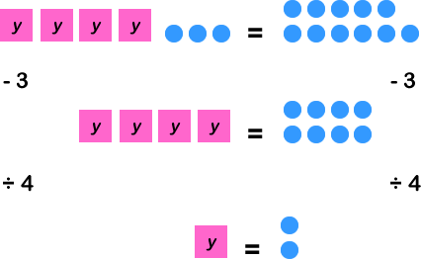
Talking time:
Sam models the equation 4y + 3 = 11.
Describe the method he uses to find the answer.

Slide 6
Talking time:
Sam models the equation 4y + 3 = 11.
Describe the method he uses to find the answer.
First, Sam subtracts 3 from both sides of the equals sign. He does this from both sides so that the equation remains balanced. By subtracting 3, he is left with 4 lots of y equalling 6. He can then divide both sides by 4 to find out that y equals 2. CHECK: (4 x 2) + 3 = 8 + 3 = 11

Slide 7
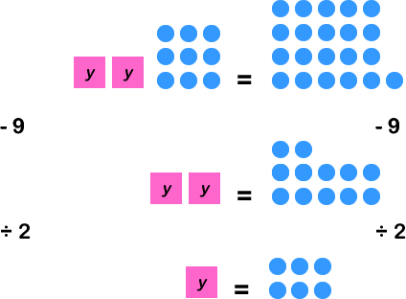
Talking time:
Describe how we can solve the two-step equation 2y + 9 = 21.

Slide 8
Activity 1:
Solve these equations using counters and cubes to model your
method.
5x + 4 = 19
10 = 3y + 4

Slide 9
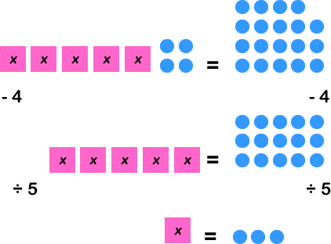
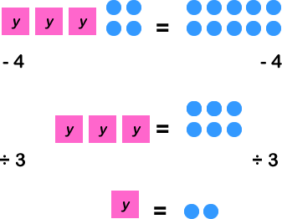
Activity 1:
Solve these equations using counters and cubes to model your
method.
5x + 4 = 19
x = 3
10 = 3y + 4
y = 2

Slide 10
Activity 2:
Solve these equations step-by-step.
64 = 4b + 32 5a + 25 = 145
0.5x + 2 = 4.5 9y – 0.3 = 45 – 0.3

Slide 11
Talking time:
Solve this equation step-by-step.
6b – = 42 –
1
7
1
7

Slide 12
Talking time:
Solve this equation step-by-step.
6b – = 42 –
6b = 42
b = 7
1
7
1
7
Both sides of the equation contain minus one seventh.
So, if we add one seventh to both sides, we can remove these expressions without changing the fact that the equation is balanced.
If six lots of b equals 42, then we can divide both sides of the equation by 6 to find out what one lot of b is worth.

Slide 13
Activity 2:
Solve these equations step-by-step.
64 = 4b + 32 5a + 25 = 145
32 = 4b 5a = 120
8 = b a = 24
0.5x + 2 = 4.5 9y – 0.3 = 45 – 0.3
0.5x = 2.5 9y = 45
x = 5 y = 5

Slide 14
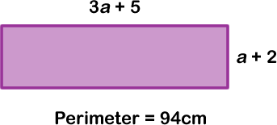
Activity 3:
What are the dimensions of this rectangle?
Explain your working.

Slide 15
Activity 3:
What are the dimensions of this rectangle?
Explain your working.
The perimeter equals two lots of 3a + 5 (which equals 6a + 10) and two lots of a + 2 (which equals 2a + 4).
If we combine these, we get 6a + 10 + 2a + 4 or 8a + 14 = 94
8a = 80
a = 10
So, the length equals (3 x 10) + 5 = 35cm
…and the width equals 10 + 2 = 12cm

Slide 16
Evaluation:
Success Criteria: I can solve two step equations I can use equipment to help me I know how to use the balancing method involving inverse operations to solve equations
True or False?
If 2b + 3 = 13, then b must be worth 10 because 10 + 3
equals 13.
If 3a + 4 = 35, then a must represent the digit 1 because
then the equation would read 31 + 4 = 35.
If 4x + 4 = 28, then x must equal 6.
If Max thinks of a number, multiplies it by 7, subtracts 10 and gets the answer
39, then this can be represented by the equation 7y – 10 = 39.
To find Max’s number in part (d), we need to subtract 10 from both sides and
then multiply both sides by 7.

Slide 17
Evaluation:
Success Criteria: I can solve two step equations I can use equipment to help me I know how to use the balancing method involving inverse operations to solve equations
True or False?
If 2b + 3 = 13, then b must be worth 10 because 10 + 3
equals 13. FALSE
If 3a + 4 = 35, then a must represent the digit 1 because
then the equation would read 31 + 4 = 35. FALSE
If 4x + 4 = 28, then x must equal 6. TRUE
If Max thinks of a number, multiplies it by 7, subtracts 10 and gets the answer
39, then this can be represented by the equation 7y – 10 = 39. TRUE
To find Max’s number in part (d), we need to subtract 10 from both sides and
then multiply both sides by 7. FALSE

