Slide 1
Ready-to-go Lesson Slides
Year 3
Measurement: Length and Perimeter
Lesson 2
Spr4

Slide 3
Starter:
Success Criteria: I know there are 100cm in 1m I can convert between centimetres and metres I can partition a measurement into metres and centimetres
Decide on an estimate in millimetres for each of these
measurements. Share your estimates.
The next slide will show the actual measurements so you can
see how accurate your estimates were!
The width of a button on a computer keyboard.
The width of a 10p piece.
The width of a pencil.
The width of a tea bag.

Slide 4
Starter:
Success Criteria: I know there are 100cm in 1m I can convert between centimetres and metres I can partition a measurement into metres and centimetres
In pairs, decide on an estimate in millimetres for each of these
measurements. Share your estimates as a class.
The next slide will show the actual measurements so you can
see how accurate your estimates were!
The width of a button on a computer keyboard.
= about 15 mm
The width of a 10p piece.
= about 25 mm
The width of a pencil.
= about 6 mm
The width of a tea bag.
= about 60 mm

Slide 5
Talking time:
What are the missing measurements on this metre stick?
1m = ____ cm
a = _____ cm
b = _____ cm
c = _____ m

Slide 6
Talking time:
What are the missing measurements on this metre stick?
1m = 100 cm
a = 40 cm
b = 50 cm
c = ½ m

Slide 7
Talking time:
What are the missing measurements on this metre stick?
100 cm = __ m
d = __ cm
e = __ cm
f = __ cm

Slide 8
Talking time:
What are the missing measurements on this metre stick?
100 cm = 1 m
d = 10 cm
e = 60 cm
f = 90 cm

Slide 9
Activity 1:
Mark these measurements on the metre stick:
½ m
¼ m
25 cm
70 cm
85 cm

Slide 10
Activity 1:
Mark these measurements on the metre stick:
½ m
¼ m
25 cm
70 cm
85 cm

Slide 11
Activity 2:
Match the equivalent measurements.
4 metres
900 centimetres
10 m
3 metres
300 cm
1 metre
100 cm
400 cm
9 m
1,000 cm

Slide 12
Activity 2:
Match the equivalent measurements.
4 metres
900 centimetres
10 m
3 metres
300 cm
1 metre
100 cm
400 cm
9 m
1,000 cm

Slide 13
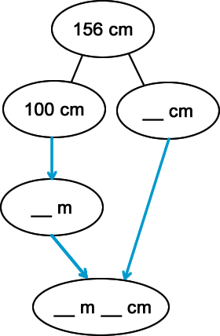
Talking time:
Complete the part-whole diagram to convert 156 cm into metres
and centimetres.

Slide 14
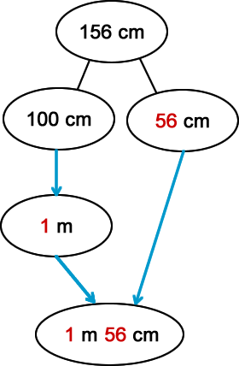
Talking time:
Complete the part-whole diagram to convert 156 cm into metres
and centimetres.

Slide 15
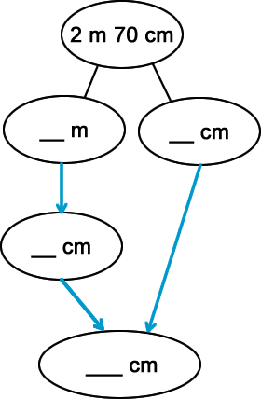
Talking time:
Complete the part-whole diagram to convert 2 m 70 cm into
centimetres.

Slide 16
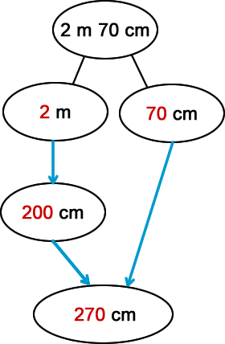
Talking time:
Complete the part-whole diagram to convert 2 m 70 cm into
centimetres.

Slide 17
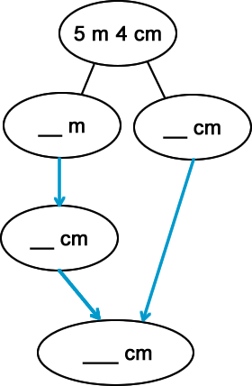
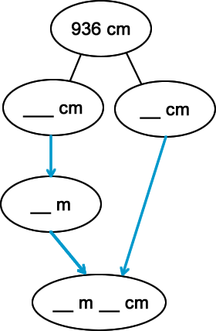
Activity 3:
Convert these measurements using part-whole diagrams to help.

Slide 18
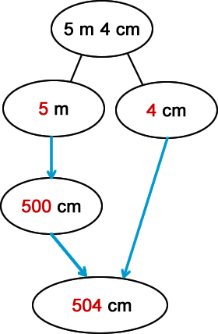
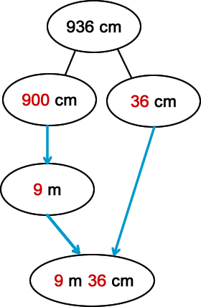
Activity 3:
Convert these measurements using part-whole diagrams to help.

Slide 19
Activity 4:
Joe says,
Do you agree with Joe? Explain your answer.
150 cm is longer than 2 m
because 150 is a larger number than 2.

Slide 20
Activity 4:
Joe says,
Do you agree with Joe? Explain your answer.
Joe is not correct. It does not matter whether 150 is a larger number or not because they are both different units of measurement. If we convert 2 metres into centimetres, we can put both measurements into the same unit. This makes them easier to compare:
150 cm is shorter than 200 cm
150 cm is longer than 2 m
because 150 is a larger number than 2.

Slide 21
Evaluation:
Success Criteria: I know there are 100cm in 1m I can convert between centimetres and metres I can partition a measurement into metres and centimetres
True or False?
There are 100m in 1cm.
500 cm = 5 m
212 cm is the same as 21 m and 2 cm.
308 cm is the same as 3 m and 8 cm.
This conversion has been completed correctly:

Slide 22
Evaluation:
Success Criteria: I know there are 100cm in 1m I can convert between centimetres and metres I can partition a measurement into metres and centimetres
True or False?
There are 100m in 1cm. FALSE
500 cm = 5 m TRUE
212 cm is the same as 21 m and 2 cm. FALSE
308 cm is the same as 3 m and 8 cm. TRUE
This conversion has been completed correctly:
TRUE

