Slide 2
Diving into Mastery Guidance for Educators
Each activity sheet is split into three sections, diving, deeper and deepest, which are represented by the following icons:
These carefully designed activities take your children through a learning journey, initially ensuring they are fluent with the key concept being taught; then applying this to a range of reasoning and problem-solving activities.
These sheets might not necessarily be used in a linear way. Some children might begin at the ‘Deeper’ section and in fact, others may ‘dive straight in’ to the ‘Deepest’ section if they have already mastered the skill and are applying this to show their depth of understanding.
Diving
Deeper
Deepest

Slide 3
Aim
Recognise, describe and build simple 3-D shapes, including making nets.

Slide 4
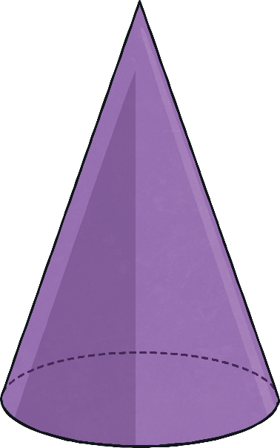
Nets of 3D Shapes
Diving
Which 3D shape can be assembled using this net?
g
cylinder
cylinder
cuboid
cone
cuboid
cone

Slide 5
Nets of 3D Shapes
Diving
Which of the nets would make a cylinder? Is there more than one possibility?
A
B
C

Slide 6
Nets of 3D Shapes
Diving
Which of these would make a square-based pyramid?
A
B
C
D

Slide 7
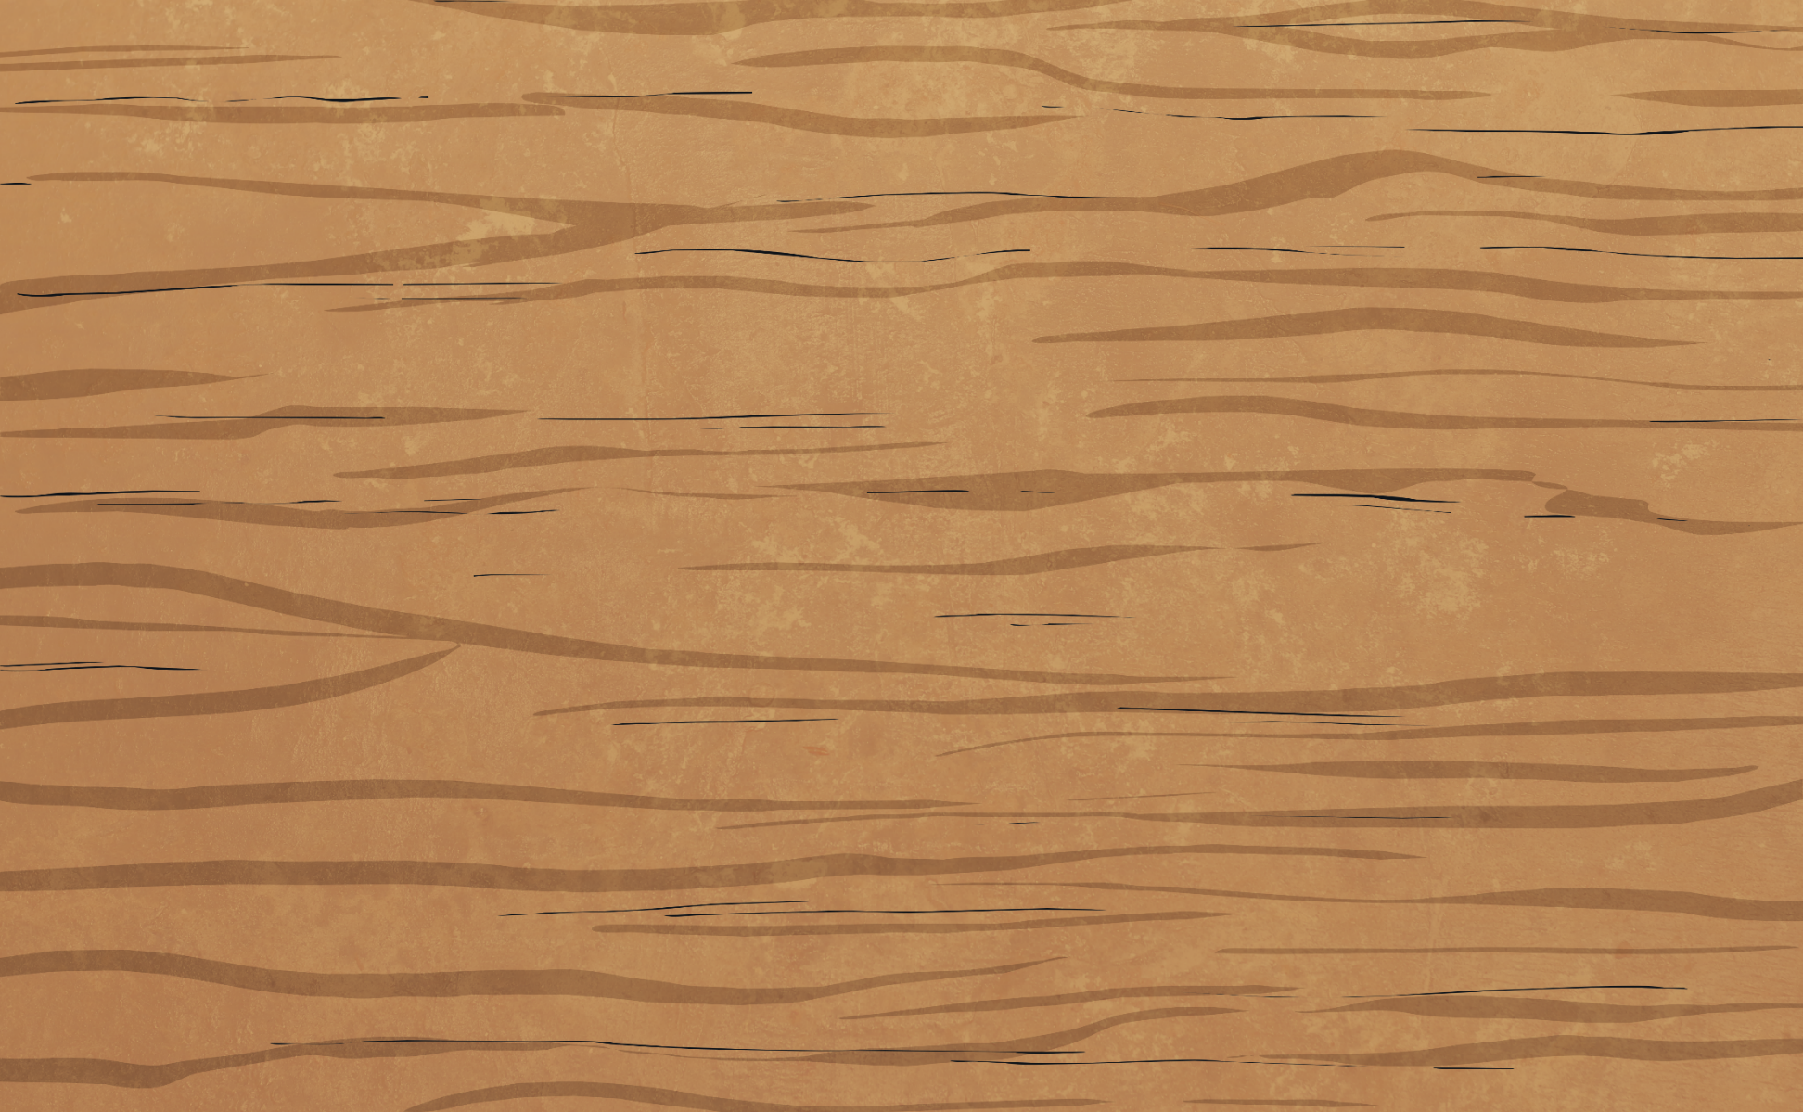
Insert White Rose Aim Here
Nets of 3D Shapes
Deeper
How many 2D shapes are needed to complete this net of a prism?
5 2D shapes are needed to complete the net. 4 more rectangles and 1 octagon.
What is the name of the 3D shape represented by the net?

Slide 8
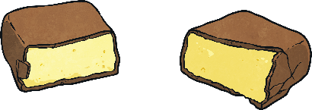
Insert White Rose Aim Here
Nets of 3D Shapes
Deeper
Year 6 are discussing nets of real-life objects.
You cannot make a net of the chocolate box because there are too many sides.
Sophie
Do you agree with Sophie? Explain with reasoning.
Sophie is incorrect. It doesn’t matter how many sides a 3D shape has, a net can still be made.

Slide 9
Insert White Rose Aim Here
Nets of 3D Shapes
Deeper
Tariq is discussing the possibility of constructing 3D shapes from nets.
It is impossible to make a net for a 3D shape using the shapes I have.
Tariq is incorrect. You can use 1 rectangle and 2 circles to create a net of a cylinder.
Do you agree with Tariq? Explain with reasoning.

Slide 10
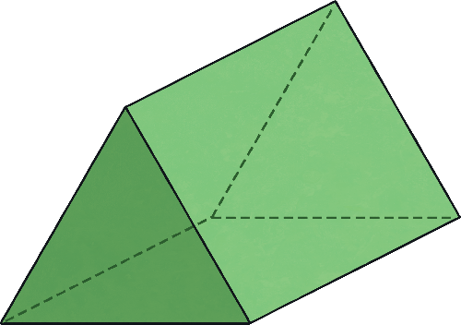
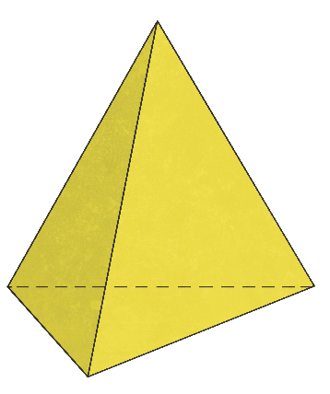
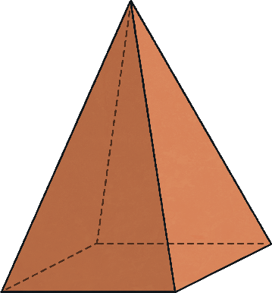
Insert White Rose Aim Here
Nets of 3D Shapes
Deeper
A variety of answers including: tetrahedron, square-based pyramid and triangular prism.
Here is part of a net from a 3D shape. Which 3D shapes could it be?

Slide 11
Nets of 3D Shapes
Deepest
This statement is sometimes true as there are both nets with an even number of shapes and an odd number of shapes. For example:
Shawn is discussing nets of 3D shapes.
Is this always, sometimes or never true? Prove it giving examples.
Shawn
Nets with an Even Number of Faces | Number of Faces
tetrahedron | 4
cone | 2
cube | 6
cuboid | 6
octagonal prism | 10
Nets with an Odd Number of Faces | Number of Faces
cylinder | 3
square-based pyramid | 5
pentagonal prims | 5
triangular prism | 5
rectangular based pyramid | 5
Nets of 3D shapes are made up of an even number of 2D shapes.

Slide 12
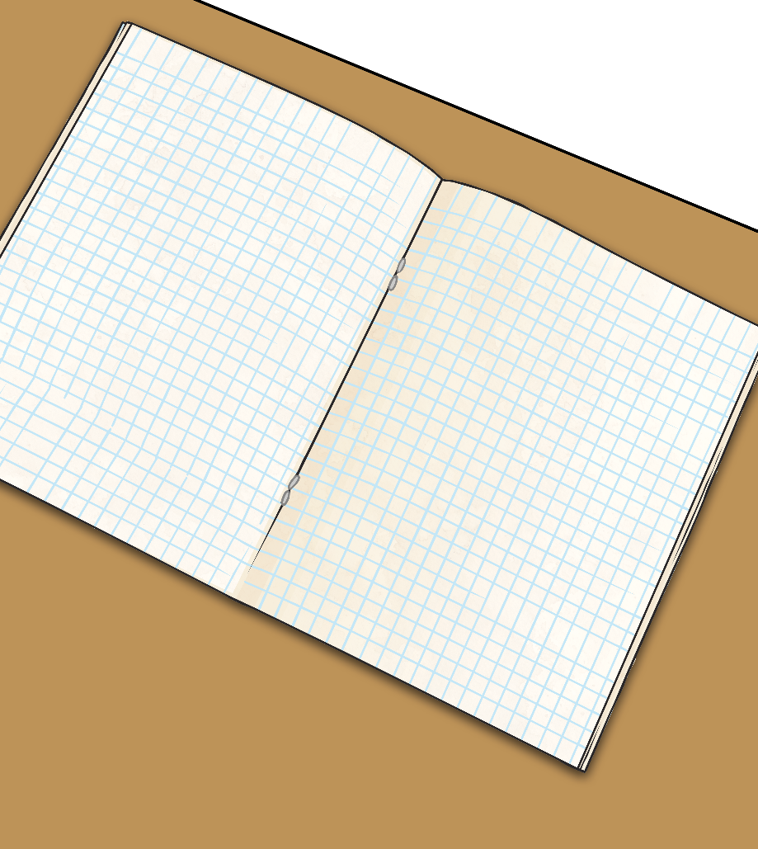
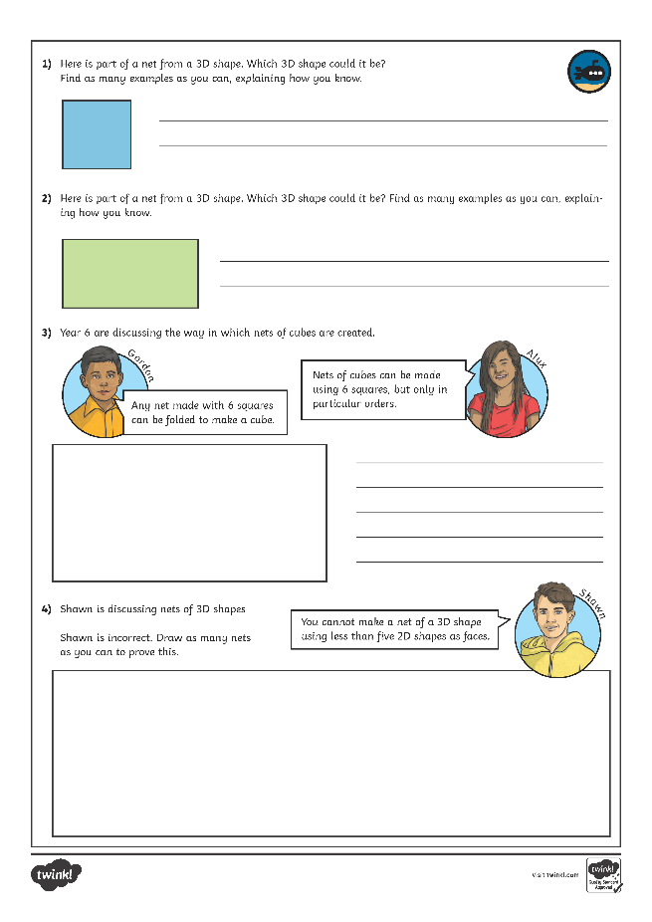
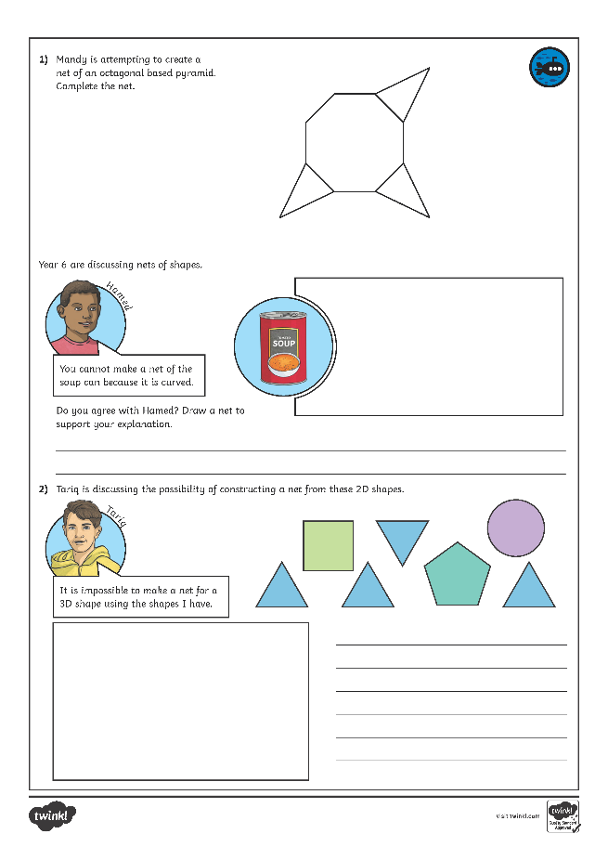
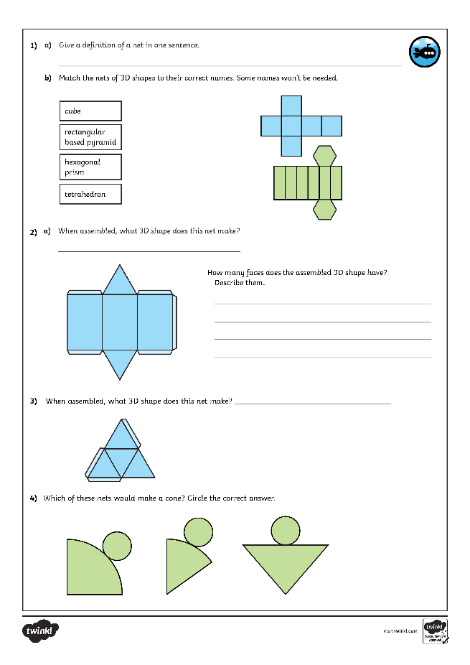
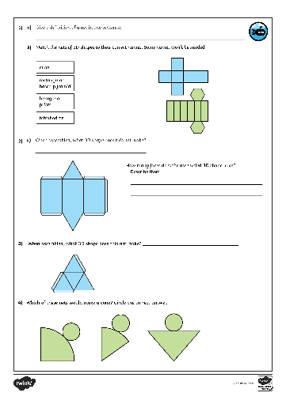
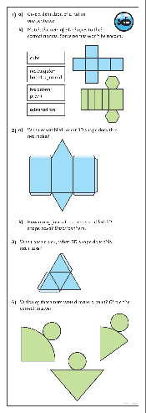
Nets of 3D Shapes
Dive in by completing your own activity!

Slide 13
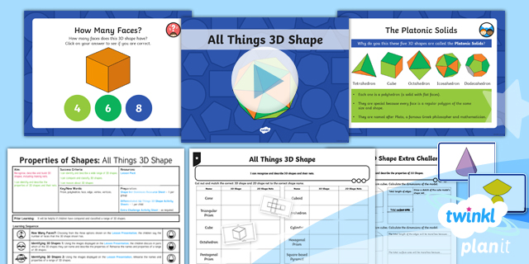
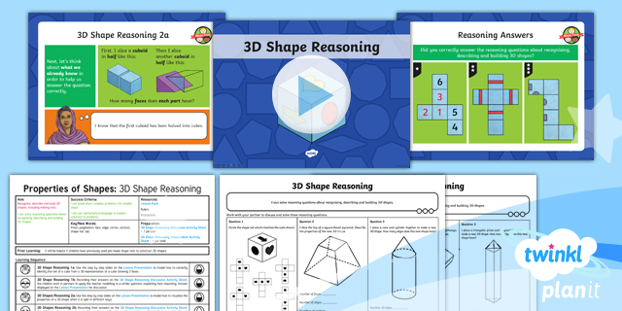
Need Planning to Complement this Resource?
National Curriculum Aim
recognise, describe and build simple 3-D shapes, including making nets.
For more planning resources to support this aim, click here.
Twinkl PlanIt is our award-winning scheme of work with over 4000 resources.

