Slide 1
Ready-to-go Lesson Slides
Year 3
Measurement: Length and Perimeter
Lesson 1
Spr4

Slide 3
Starter:
Success Criteria: I know what millimetres are I can measure length by choosing whether to use a ruler, tape measure, metre stick or trundle wheel
In pairs, decide on an estimate for each of these measurements.
Share your estimates as a class.
The next slide will show the actual measurements so you can
see how accurate your estimates were!
The length of a £5 note.
The width of a mug.
The length of a pillow.
The length of a credit card.

Slide 4
Starter:
Success Criteria: I know what millimetres are I can measure length by choosing whether to use a ruler, tape measure, metre stick or trundle wheel
In pairs, decide on an estimate for each of these measurements.
Share your estimates as a class.
The next slide will show the actual measurements so you can
see how accurate your estimates were!
The length of a £5 note.
= 12 ½ cm
The width of a mug.
= 8 cm
The length of a pillow.
= 66 cm
The length of a credit card.
= 8 ½ cm

Slide 5
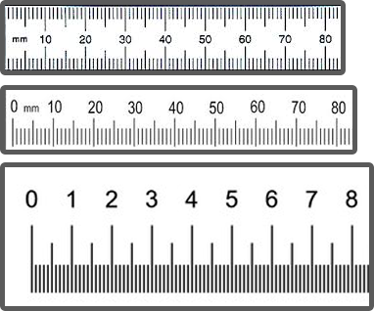
Talking time:
What is the same? What is different?

Slide 6
Talking time:
What is the same? What is different?
Each of the rulers can be used to measure in centimetres and millimetres as they all have the correct notches marked. However, the numbering on the first two rulers shows millimetres and the third ruler is numbered in centimetres.
With the first ruler, 0 is not marked, but the scale begins at the very end of the ruler, so that is where we would begin to measure from. With the second and third rulers, we would need to align the 0 with the end of the thing we are measuring as there is a small space before the scale begins.

Slide 7
Talking time:
In this zoomed-in image, what is the length of the green line
in millimetres?
.

Slide 8
Talking time:
In this zoomed-in image, what is the length of the green line
in millimetres?
The line is 69 mm long.
Extension:
You may be viewing this on an interactive whiteboard or a computer screen.
Use a ruler to measure the actual size of the line on the screens!

Slide 9
Talking time:
In this zoomed-in image, what is the length of the red line?
Give your answer in millimetres, in centimetres and in
centimetres and millimetres.

Slide 10
Talking time:
In this zoomed-in image, what is the length of the red line?
Give your answer in millimetres, in centimetres and in
centimetres and millimetres.
The line is 47mm long.
This is the same as 4.7 cm.
It is also the same as 4 cm 7 mm.

Slide 11
Activity 1:
You will need a ruler (that shows millimetres), a pencil and
piece of paper.
Draw 6 lines of different lengths and label them A - F.
Measure each line carefully and record the measurements
separately so that you know what the answers are.
Swap your piece of paper with a friend so that you can both
measure each other’s lines.
Give each measurement in:
- millimetres
- centimetres
- centimetres and millimetres

Slide 12
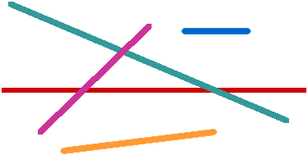
Activity 2:
Measure these lines to the nearest millimetre.
Depending on how you are viewing this slide, you may need to zoom out to make the image a little smaller!
There is no answer slide that follows this one as your answer will be different,
depending on how large the image looks.

Slide 13
Talking time:
Match each length with the unit you would choose to measure
it with.
The length of an envelope
millimetres
The width of a pencil
centimetres
The length of your classroom
The thickness of a book
metres
The height of a door

Slide 14
Talking time:
Match each length with the unit you would choose to measure
it with.
The length of an envelope
millimetres
The width of a pencil
centimetres
The length of your classroom
The thickness of a book
metres
The height of a door
You may have chosen different answers to these.
Why did you choose the answers you did?
Does it matter which unit you use?

Slide 15
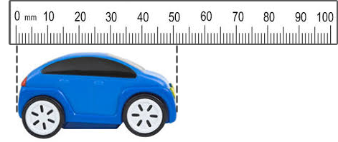
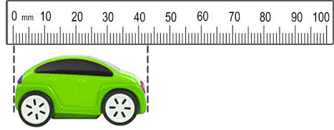
Activity 3:
What is the length of each toy car?
Give your answers in millimetres.

Slide 16
Activity 3:
What is the length of each toy car?
Give your answers in millimetres.
The blue car is 51mm long.
The green car is 43mm long.

Slide 17
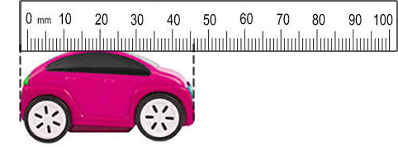
Talking time:
Abby says that the length of this car is 46mm.
Do you agree? Explain your answer.

Slide 18
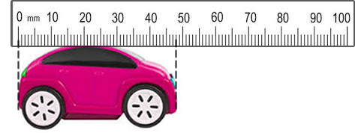
Talking time:
Abby says that the length of this car is 46mm.
Do you agree? Explain your answer.
The car is not 46mm long. This is because Abby has
not measured it from the start of the scale (where the
0 is). Instead, she has lined up the end of the ruler
with the car. However, there is a gap before the ruler
scale begins. The car should be measured like this:

Slide 19
Activity 4:
Kyle has a broken ruler.
He says, “I can still measure the length of this car.”
Is Kyle correct? Explain your answer.

Slide 20
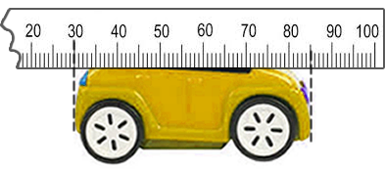
Activity 4:
Kyle has a broken ruler.
He says, “I can still measure the length of this car.”
Is Kyle correct? Explain your answer.
Kyle is correct. He can still use the ruler as long as he counts from zero from wherever he begins to measure from. For example, he can line the end of the car up with the number 30mm and then start counting from this point. The car goes as far as the 85mm point and so from 30 to 85 is 55mm. The car is 55mm long.

Slide 21
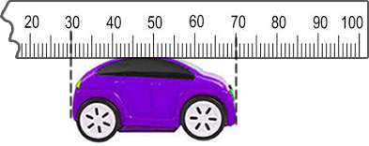
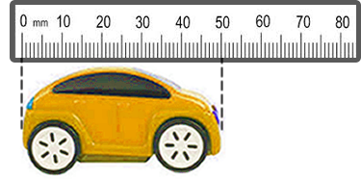
Evaluation:
Success Criteria: I know what millimetres are I can measure length by choosing whether to use a ruler, tape measure, metre stick or trundle wheel
True or False?
10 millimetres are longer than 1 centimetre.
The purple car is 70 mm long.
When using a ruler, we don’t always start measuring from the very end of the ruler.
The yellow car is 5 cm long.

Slide 22
Evaluation:
Success Criteria: I know what millimetres are I can measure length by choosing whether to use a ruler, tape measure, metre stick or trundle wheel
True or False?
10 millimetres are longer than 1 centimetre. FALSE
The purple car is 70 mm long. FALSE
When using a ruler, we don’t always start measuring from the very end of the ruler. TRUE
The yellow car is 5 cm long.
TRUE

