Slide 2
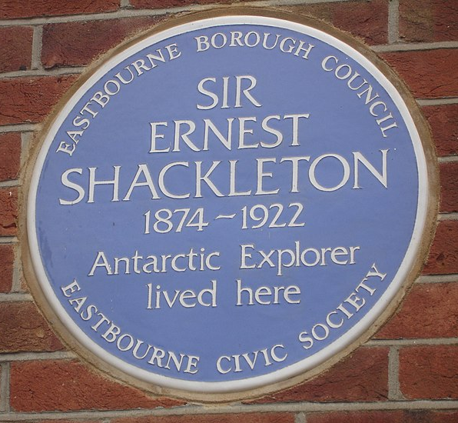
100 Years
Sir Ernest Henry Shackleton was a polar explorer who attempted to reach the South Pole in the early 1900s. His bravery earned him a knighthood.
Shackleton’s most famous expedition was the ‘Endurance mission’ of 1907-1909.
Shackleton died suddenly on 5th January 1922 at the beginning of his fourth Antarctic expedition.
On the 100th anniversary of his death, we remember and celebrate Ernest Shackleton’s life.
“Sir Ernest Shackleton” by [Oxyman] is licensed under CC BY 2.0

Slide 3
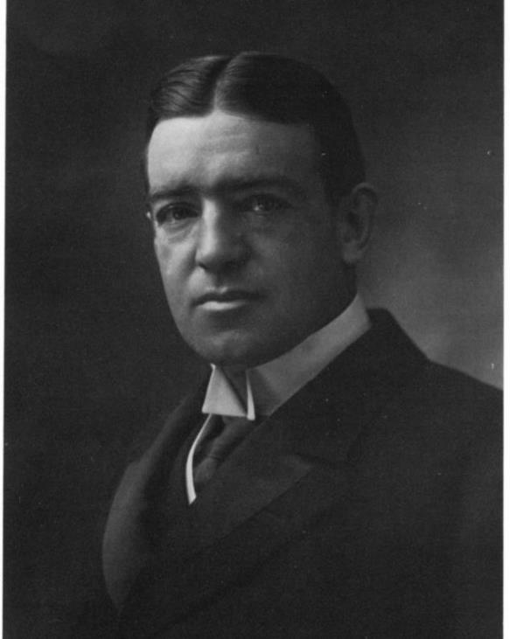
Who Was Ernest Shackleton?
Ernest Shackleton was born in Ireland in 1874. He was the second oldest of 10 children.
He lived in Ireland until 1884, when his family moved to South London.
His father was a doctor and wanted Ernest to follow in his footsteps.
However, Ernest had a different idea about what he wanted to do.

Slide 4
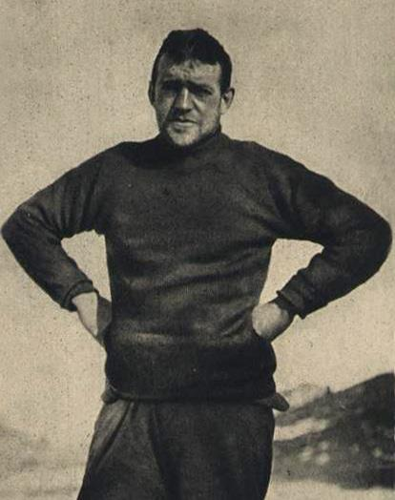
What Did Shackleton Do?
At the age of just 16, Shackleton joined the merchant navy and became a sailor.
In 1898, he qualified as a master mariner, which meant that he was able to sail a British ship anywhere in the world.
This allowed him to fulfil his dream of becoming an explorer. Shackleton wanted to reach the South Pole.
master mariner - The highest grade of seafarer qualification.

Slide 5
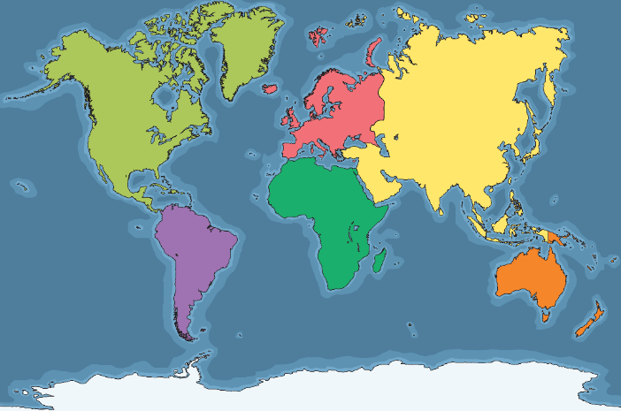
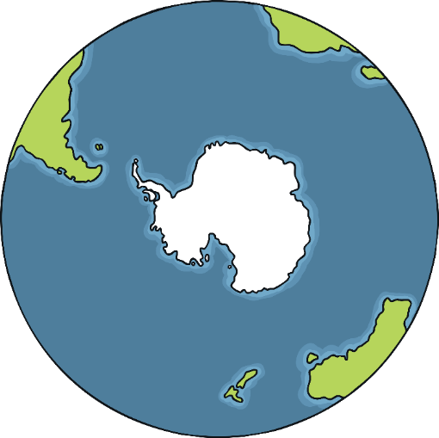
The South Pole
Do you know which continent the South Pole is in?
North America
Europe
Asia
South America
Africa
Antarctica
Australasia
The South Pole is in Antarctica.

Slide 6
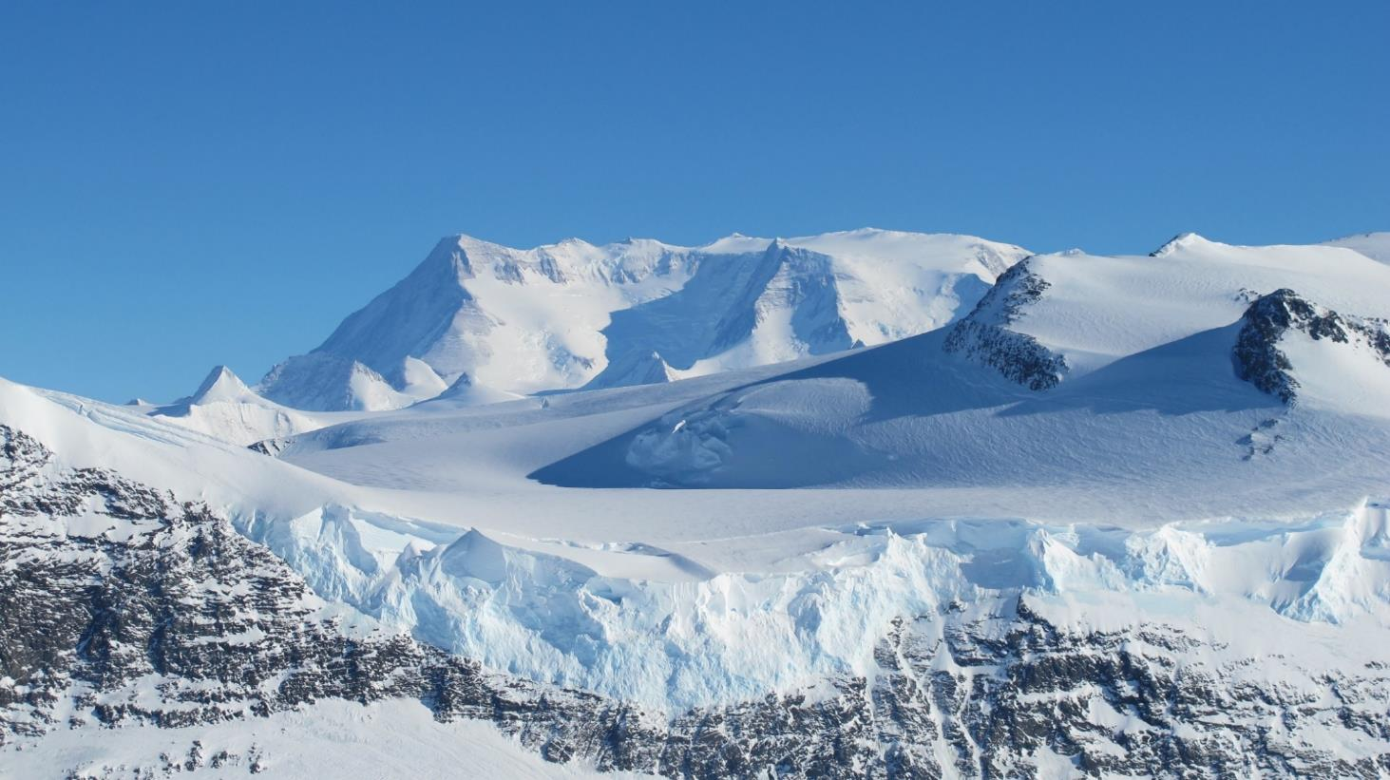
Antarctica
Antarctica is the coldest, driest and windiest continent on Earth.
Although it is covered in ice and snow, it is dry because it hardly ever rains.
It is very difficult for plants, animals and people to survive here.

Slide 7
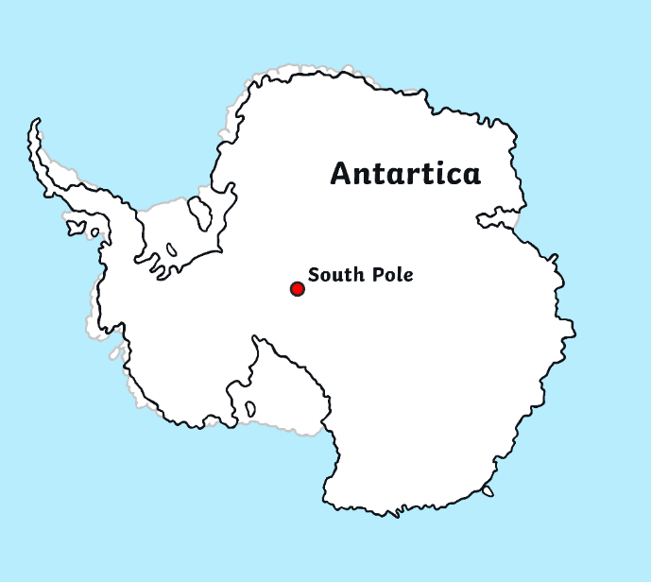
Antarctica
For thousands and thousands of years, no humans had ever been to Antarctica. They weren’t even sure it existed!
In the 18th and 19th centuries, many brave explorers tried to find it.
Eventually, humans found Antarctica!
Once the continent had been discovered, the next challenge was to learn more about it. Explorers also planned to reach the South Pole, but it would not be an easy expedition...
Why do you think it would not be ‘an easy expedition’?

Slide 8
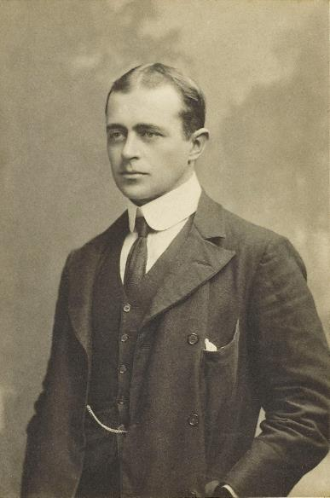
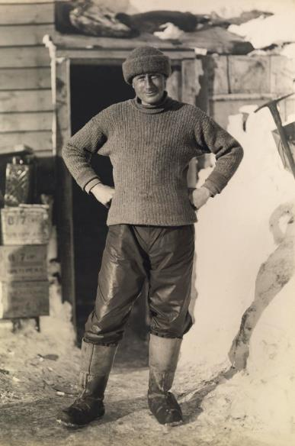
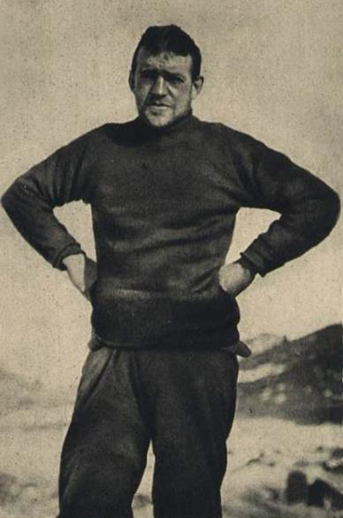
Shackleton’s First Mission
In July 1901, 27-year-old Ernest Shackleton set off on his first mission on board the ‘Discovery’, with fellow explorers Robert Falcon Scott, Edward Wilson and others. Their aim was to find out more about the unknown and untouched continent.
Scott
Wilson
Shackleton

Slide 9
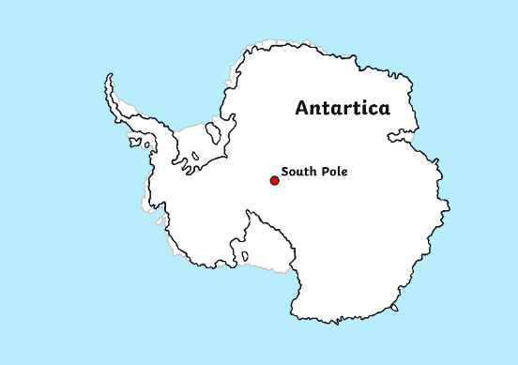
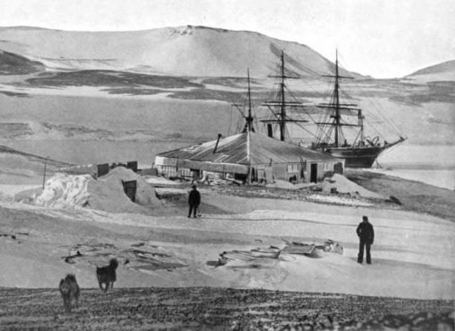
Shackleton’s First Mission
The team travelled on a sledge pulled by dogs. They reached further south than anyone had before!
However, they were forced to turn back before they could reach the South Pole due to the terrible weather conditions.
By the time they had returned to their ship, the explorers were all suffering from scurvy, snow-blindness and frostbite to their fingers and toes.
Shackleton was very unwell and sent home early but he had gained lots of useful experience.
Did You Know…?
Scurvy is an illness caused by not eating any fresh fruit or vegetables for three or more months.

Slide 10
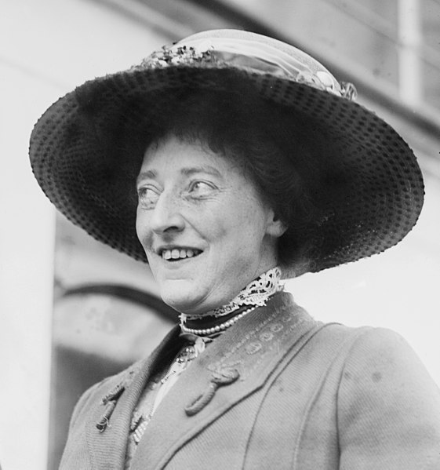
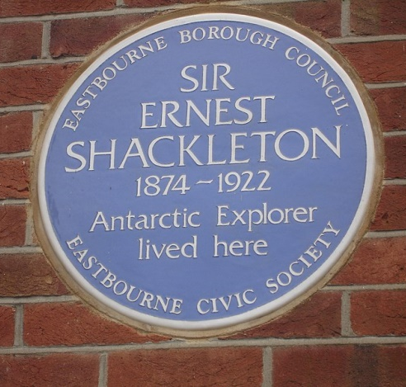
Emily Dorman
On 9th April 1904, Ernest Shackleton married Emily Dorman.
Their family house was in Eastbourne, East Sussex. There, Emily raised three children by herself because Shackleton was so frequently away from home. She supported him and played an important role in his work by raising money for his missions.
She said this about her adventurous husband:
“You can’t keep an eagle caged in your backyard”.
What do you think Emily meant by this statement?
“Sir Ernest Shackleton” by [Oxyman] is licensed under CC BY 2.0

Slide 11
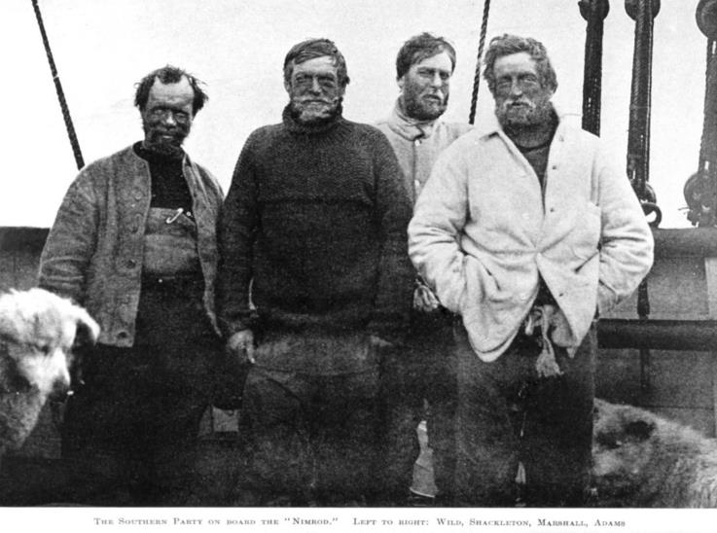
Shackleton's Second Expedition
Between 1907 and 1909, Ernest Shackleton made another attempt to reach the South Pole, on board the ‘Nimrod’.
Shackleton
Can you spot their sledge dogs?
Alongside him were Frank Wild, Eric Marshall and Jameson Adams.

Slide 12
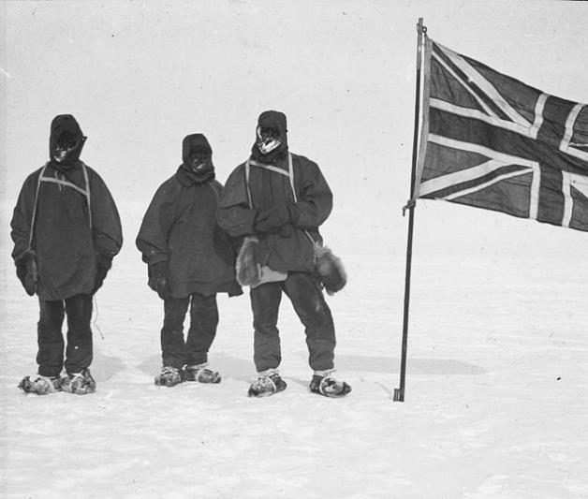
Nimrod Expedition
Despite terrible weather conditions, Shackleton and his team managed to come within 180km of the South Pole, before deciding to turn back on 9th January 1909.
This set the record for the closest anyone had ever come to the South Pole!
When Ernest returned home, he was made a Commander of the Royal Victorian Order and received a knighthood, becoming Sir Ernest Shackleton.
Shackleton and some of his team in Antarctica

Slide 13
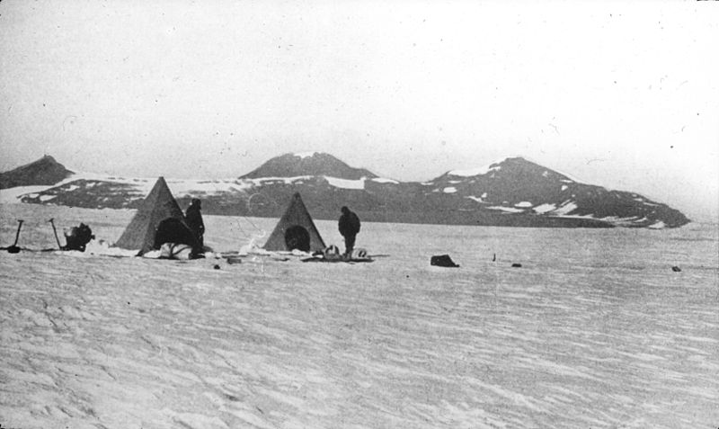
Nimrod Expedition
Camping in Antarctica, Nimrod Expedition

Slide 14
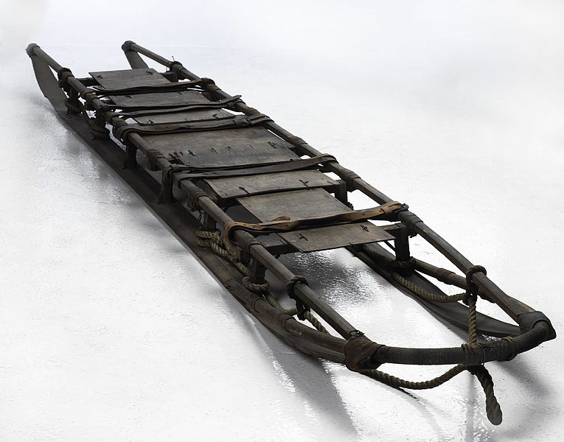
Mystery Object
Can you guess what this object is? Clue: it was used during the expedition.
?
?
?
Sledge used during the Nimrod expedition, between 1907 and 1909
“Bertram Armytage, British Antarctic Expedition, 1907-1909” by [Museum Victoria] is licensed under CC BY 4.0

Slide 15
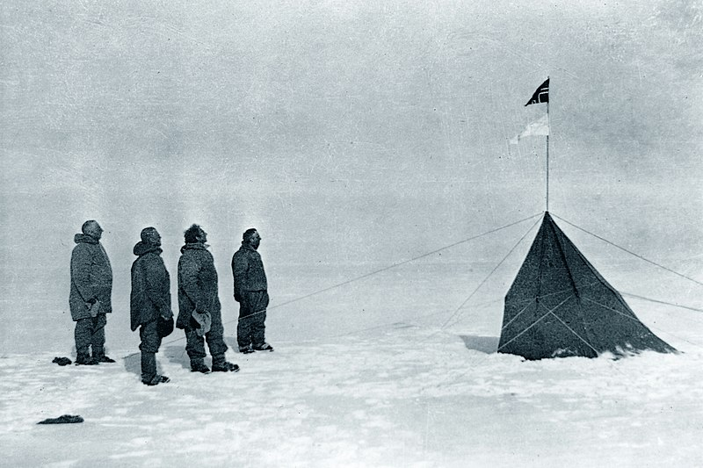
Disappointment for Shackleton
Just a few years later, Shackleton's dream of becoming the first person to set foot on the South Pole was shattered.
In December 1911, he received news that the Norwegian explorer, Roald Amundsen, and his team had become the first people on Earth to set foot on the South Pole.
The Norwegian team at the South Pole,
December 1911
(L-R) Roald Amundsen, Helmer Hanssen, Sverre Hassel and Oscar Wisting
How do you think Shackleton felt? Do you think he gave up his exploring now?

Slide 16
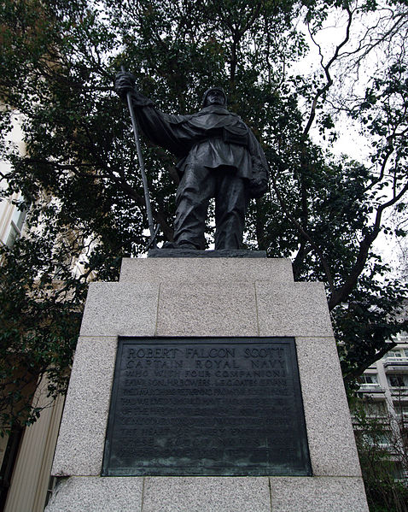
Tragedy for Scott
Robert Falcon Scott (who had travelled with Shackleton on the ‘Discovery’) had also been travelling to the South Pole at the same time.
However, on arrival at the South Pole, Scott discovered that he and his team had been beaten by the Norwegian explorer!
Tragically, Scott and his team died on the dangerous journey back home across the ice.
Statue of Robert Falcon Scott in Westminster, London
“London waterloo pl scottstatue 30.01.2012 13-26-17.2012 13-26-17” by [Dirk Ingo Franke] is licensed under CC BY 3.0

Slide 17
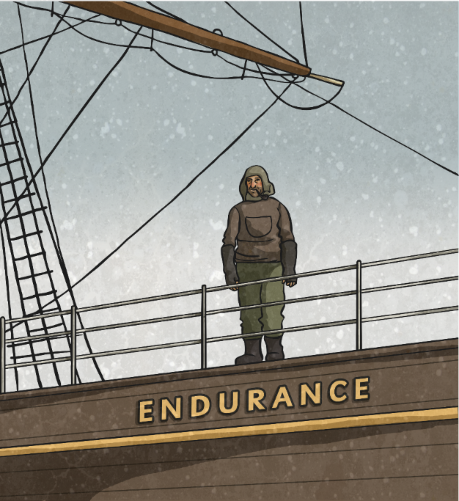
What Next for Shackleton?
Shackleton did not give up! He wanted to explore further.
Now he set himself a new goal of crossing the entire continent of Antarctica in one expedition. His next mission would be his most famous.
Shackleton wrote an advert to ask for people to join him. He warned them to expect cold temperatures, low wages and dangerous conditions.
In 1914, with a new team, he began an exploration on board a ship called ‘Endurance’.
During this mission, Shackleton recorded geological and scientific data about Antarctica.

Slide 18
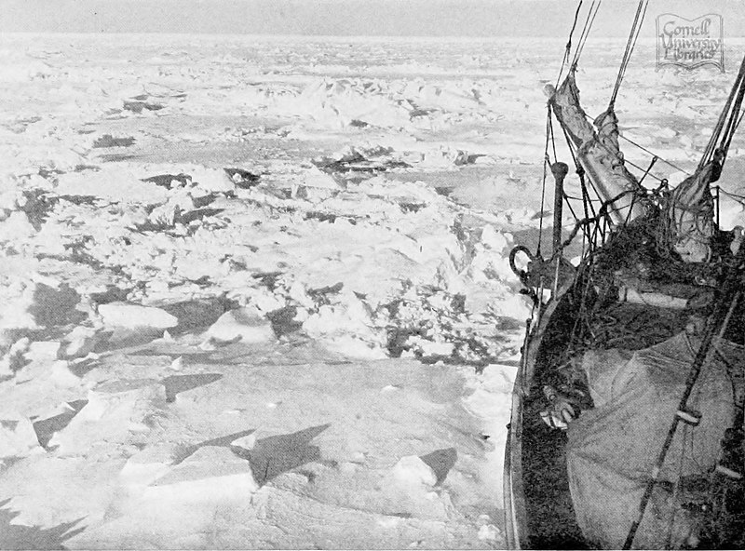
Shackleton’s Third Expedition
In early 1915, disaster struck as the Endurance became trapped in the ice off the Antarctic coast.
Shackleton and his men abandoned the ship and had to live on the ice. As their food rations ran out, they had to eat seal meat, penguins and their dogs.
Finally, in the spring of 1916, the ice began to thaw.
Shackleton and his team boarded small boats and headed for nearby Elephant Island. But when they had arrived, they soon realised the island was deserted!

Slide 19
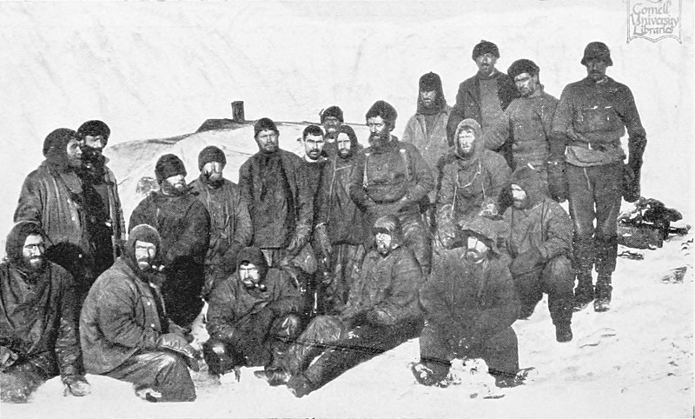
Shackleton’s Third Expedition
Shackleton and five men took a small lifeboat to South Georgia to seek help, leaving everyone else behind.
Once they had arrived, they were able to organise a rescue mission for the other men marooned on the island.
Shackleton and his team were on the ice for almost two years but thanks to Shackleton’s bravery and heroic actions in what seemed like a hopeless situation, nobody died.
The men marooned on Elephant Island
How do you think the marooned men felt being left on the deserted island?

Slide 20
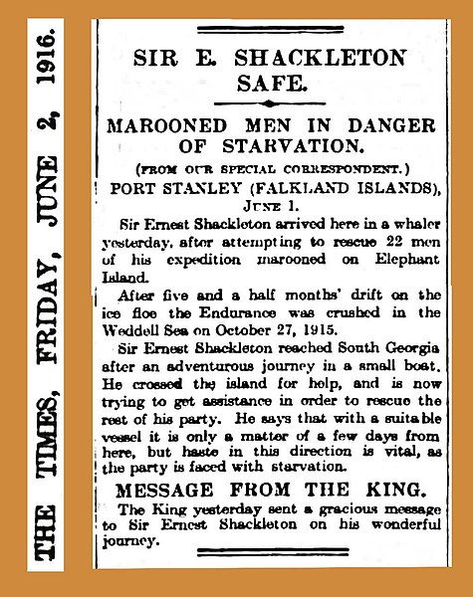
Endurance Expedition
The Endurance mission is thought of as Shackleton’s most successful expedition. Despite not reaching the South Pole and experiencing awful conditions, nobody died in two years of travelling Antarctica.
'South', Shackleton’s book of the Endurance expedition, was published in 1919 and became a bestseller.
Incredibly, one hundred years later, in March 2022, the shipwreck of Endurance was found 3008 metres below sea level.

Slide 21
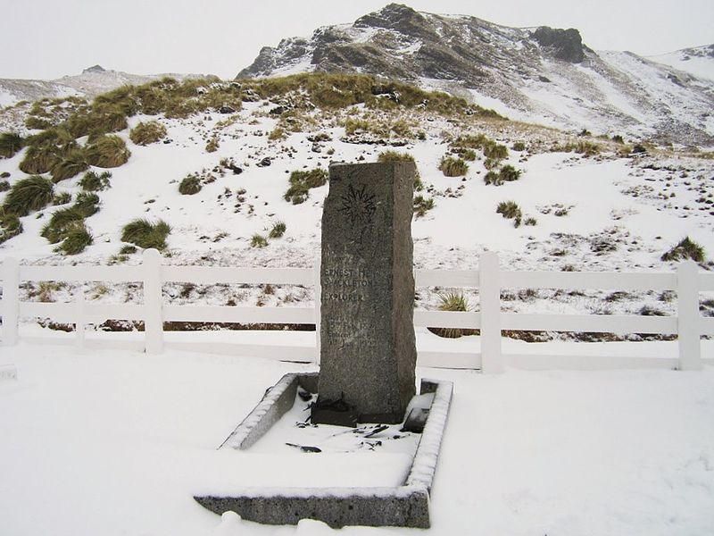
What Happened to Shackleton?
In January 1922, at the start of his fourth Antarctic expedition, ‘Quest’, Shackleton died suddenly, aged 47, from a heart attack.
It is thought that this stress and effort of planning this expedition may have caused his death.
Shackleton was buried in a cemetery in South Georgia, a small and remote island in the Atlantic ocean.
“Grave of Sir Ernest Shackleton” by [David Stanley] is licensed under CC BY 2.0

Slide 22
A Famous Biscuit
In 2011, a 104-year-old biscuit that had been leftover from the Nimrod Expedition was sold at auction for £1250.
The biscuits were an important part of the food rations for Shackleton and his explorers. They were fortified with milk protein, although they did not contain any Vitamin C because this was not thought of as important at that time.
Do you know why vitamin C is so important?
Vitamin C is found in fresh fruit and vegetables. Without Vitamin C, your body will develop scurvy.

Slide 23
1874 - 1922
Sir Ernest Shackleton will be remembered for his brave efforts and determination to explore the unknown continent of Antarctica. He made many geological and scientific discoveries.
On the 100th anniversary of his death, we remember and celebrate Ernest Shackleton’s life and achievements.

